Slide 1
Finding “rough” diamonds despite WC / Sovereign immunity or Med Mal barriers
Aaron Clemens

Slide 2

INTRODUCTION
Aaron Clemens – Romano Law Group

Slide 3




Benefits of WC claims
MEDICAL TREATMENT
INDEMINITY
LIEN BOARDABLE
AVENUE FOR SUIT
Paid by WC carrier
Lost wages
Helpful for PI cases
Wrongly denied

Slide 4




DRAWBACK of WC claims
MEDICAL TREATMENT
INDEMINITY
LIEN BOARDABLE
IMMUNITY
Chosen by WC carrier
Only partial
lost wages
Less than typical
medical lien
Unless they wrongly
deny, may be stuck

Slide 5
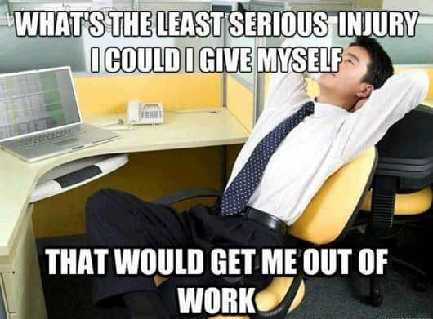
HOW does WC LAW affect a PI practice?
Aren’t most WC cases:
  Sprains, strains, tears
  Bruise / contusion
  Minor cuts / punctures
  Inflammation
    Wear/tear on the body
    Standing on hard surface
    Typing/sitting immobile
  Cases with limited injury, PI lawyers often cannot help injured worker
  Better to stay in WC system

Slide 6
WC CASES THAT NEEDS TORT LAWYERS
Issue spotter: who else can you sue? Examples
Government employee on job (surgery) – no WC claim pursued (guy near retirement)
  Sued business for owning car & employing driver who caused car crash.
Police on patrol fell in hole at home outside pool, hurt back (surgery)
  Homeowner landlord left uncovered hole on property (could also sue tenant if removed warning sign)
Security guard on patrol injured leg (surgery)
  Different business strung wire dangerously on his path;
Small business employee fell down-stairs (surgery)
  Homeowner insisted he wear unsafe booties (to keep property clean) knowing about slippery stairs;
Small business employee fell when working on top of shed in building (surgery)
  Country club did not warn about unpermitted building, hole in roof he tried to worked on;
Delivery company employee (several surgeries)
  Sued person causing serious car crash – also pursued UM claim, then dropped it when we finally found disability policy.

Slide 7
Subrogation & manfredo Formula
Florida Statue 440.39 & Manfredo v. Employer’s Casualty Ins. Co., 560 So.2d 1162 (Fla 1990).
Workers’ compensation insurance companies owed reimbursement from 3rd party recovery
Practice tip: DO NOT SEEK SUBROGATION WAIVER EARLY
  Wait until you’ve settled case – otherwise you lose boardable bills
WC lien (medical bills and indemnity benefits) boardable due to subrogation right
  No way even under new laws to “attack” WC bills: lien is what WC insurance already paid
Manfredo formula application on $1 mm WC lien & $1 mm tort recovery
Third party settlement/recovery $1 mm
Minus attorney fees and costs $550,000 = ($1 mm minus $450,000)
Divided by full case value ($3mm) 0.1833333333 = ($550,000 / $3 mm)
Value of $1 mm WC lien here $183,333.33
WC LIEN DOES NOT APPLY TO UM BENEFITS
Can negotiate reductions via hypothetical to tell client what they get if they settle.
Points of dispute often true value of the case (which considers liability or policy limits)

Slide 8

CATASTROPHIC INJURIES WITH Third-party fault
Considered “holy grail” cases
Gross negligence
Worker on FIU pedestrian bridge during collapse
  Solid case without WC aspect
New worker using industrial iron
  Arm caught – burned off
Construction worker, fell & paralyzed
  WC carrier denied coverage wrongly
Field worker – co-worker backed over him
  Prior lawyer secured default, without
  citating gross negligence to allow tort damages

Slide 9
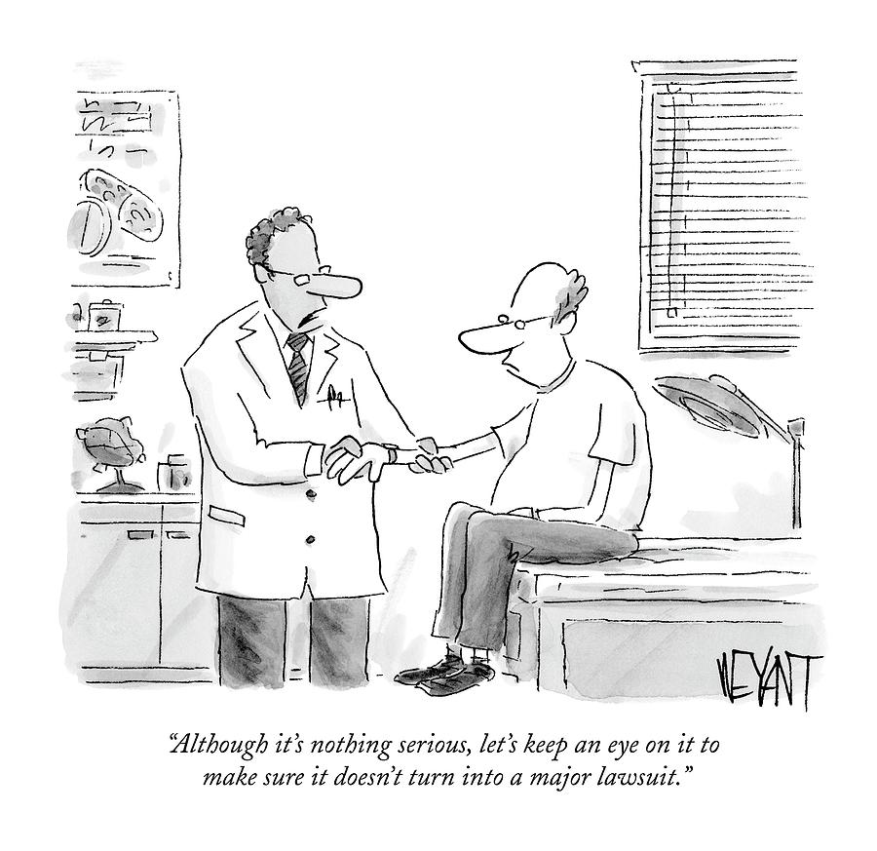
WC cases may include other serious claims
  Product liability
  Asbestos
  Airbag
  Tire failure
  Class action
  Smaller damages may add up
  Medical malpractice
  Cannot even choose your doctor under WC system

Slide 10
Immunity: PER The grand bargain
“Grand Bargain” created WC system:
Employers gave employees strict liability claim system.
Employers got immunity from most employee lawsuits.
Aimed to get people back to work, fast, by avoiding litigation.
In “Grand Bargain,” in exchange for no-fault, created immunity from employee lawsuits
To get immunity, employer needs to pay for coverage
Employer also needs to ensure their lawyer’s do not wrongfully deny
Some WC insurance company lawyers wrongfully deny claim
More likely, some employers skirt the rules, refuse to pay for coverage

Slide 11
Construction immunity
Horizontal Immunity
Vertical Immunity
Protects one subcontractor from being sued by employees of another subcontractor.
In joint enterprise, if all properly insured, only exception is if the subcontract’s gross negligence causes injury.
Injury in Island: beat M2D, settled due to grave concerns
Subcontractors (SC) under general contractor (GC) are considered employee of direct employer SC and GC at the top.
Protects general contractor also known as the “statutory employer.”
Only applies if the contractor ensures SC or GC covers employee with WC insurance.

Slide 12
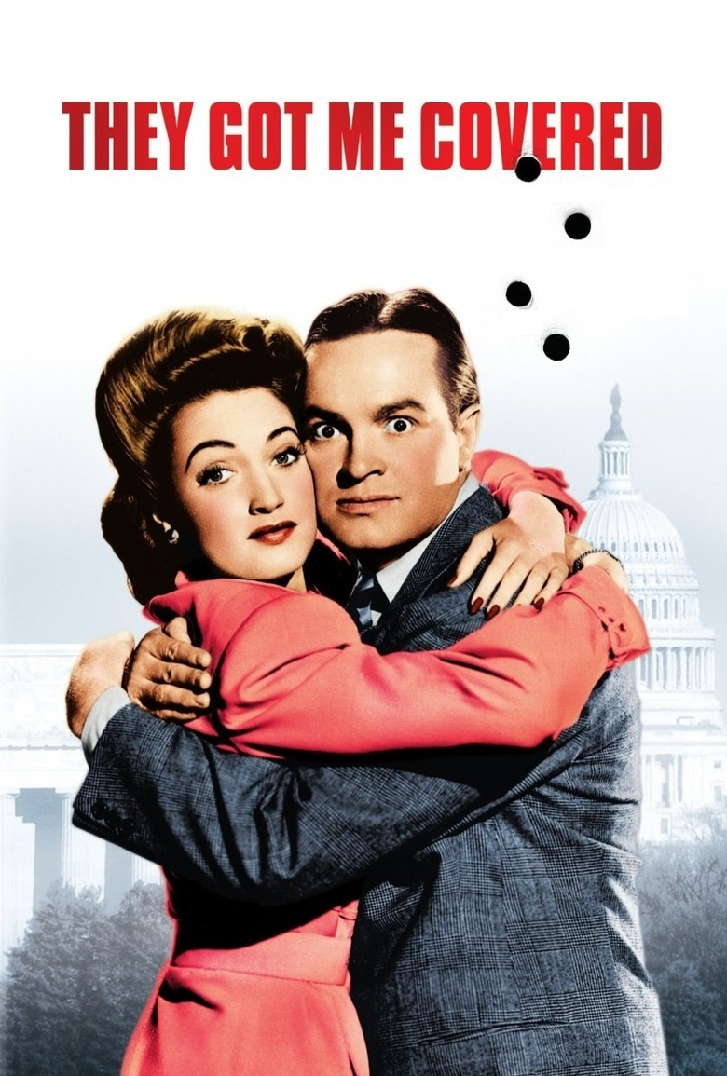
VERTICAL IMMUNITY CAN COVER EVERYBODY IN THE CHAIN
WC insurance will cover everybody in Florida
Need coverage OR exclusion
Many subcontractors exclude themselves from WC coverage
Will be deemed valid, very common
EXAMPLE ONE: Exception to exclusion
Employee (defense may contend was subcontractor)
Arguably valid exclusion of himself as executive
First issue, exclusion NOT for construction
Second issue, company dissolved long before accident
EXAMPLE TWO:
Must read contract language: “interpreted under laws of [X] state”
Other states may have different rules
In NC, vertical immunity only covers the entity paying for insurance
This, if contract interpreted under NC law, in Florida, GC is not covered

Slide 13
NEARLY IMPOSSIBLE Exceptions to immunity
Intentional-Tort Exception
Otherwise known as virtual certainty standard.
§440.11, Fla. Stat., provides an employer can be sued if employer:
1. Deliberately intended to injure the employee; or
2. Knowingly engaged in conduct virtually certain to result in injury or death to the employee, and employee was unaware of the risk as danger was not apparent and employer deliberately concealed danger to prevent employee from exercising informed judgment about danger.
Gross Negligence – applicable in horizontal immunity cases
Lower standard than virtually certain, but still very hard to prove.
More than standard negligence.
Requires willful, wanton, and reckless disregard of consequences of one’s actions or omissions.

Slide 14
TIMELINE FOR PI / WC case
Intake steps
(1) evaluate injuries, (2) contact WC attorney, (3) verify WC coverage, (4) identify potential third-party tortfeasors, (5) verify tortfeasor policy limits (or assets) to decide on potential claims
Pre-suit steps
Stabilize client medically, try to settle WC, get final lien and use this to seek BI settlement. Use WC medical records as proof of hard-to-impeach proof of injuries.
Litigation steps
File lawsuit against any non-settling parties, can levy WC lien and WC records / doctors in PI suit - sometimes better to get out of WC system to get higher quality care.
FYI, WC doctors are very difficult to impeachable
Final steps
After you win or settle, resolve WC liens (Manfredo formula) before you pay out case (not counting any UM claims)

Slide 15
BORROWED SERVANT DOCTRINE
Gig economy – use of PEO
Temp employees travel
Many companies use professional employer organization (PEO) or temp agency to reduce employee costs.
​Temp agencies protected under §440.11(2), Fla. Stat., and so are employers who utilize them, as borrowed servants
Whether a person is considered a borrowed agent is typically a jury question.
Temp employees get WC from agency, and make WC claims under that insurance
Such WC coverage may not protect suits against different parties
Temp employee assigned to trucking company, drove to fruit packer – immunity for temp agent, not for trucking or packing companies: suffered devastating injury

Slide 16
Consider all options for injured workers
WC case benefits
Tort benefits
Miscellaneous cases
No real risk if in good faith (except to settle you quit)
​Fla. Stat. 440.205 – illegal to discriminate for making a claim
Provides lien to pursue in PI
Filed in WC, so have lien
Hard for defense to claim meds biased
WC carrier could wrongly deny, then waive immunity or certain defense
May get WC case referral fee
Med mal​
Product liability
Class action
Disability claim, can include private and social security cases (be aware of offsetting for WC benefits)

Slide 17

Sovereign Immunity: the king can do no wrong, notion of prima nocte
Braveheart: not necessarily historically accurate, can still convey a message

Slide 18
Florida statute §768.28
(1) In accordance with s. 13, Art. X of the State Constitution, the state, for itself and for its agencies or subdivisions, hereby waives sovereign immunity for liability for torts, but only to the extent specified in this act. Actions at law against the state or any of its agencies or subdivisions to recover damages in tort for money damages against the state or its agencies or subdivisions for injury or loss of property, personal injury, or death caused by the negligent or wrongful act or omission of any employee of the agency or subdivision while acting within the scope of the employee’s office or employment under circumstances in which the state or such agency or subdivision, if a private person, would be liable to the claimant, in accordance with the general laws of this state, may be prosecuted subject to the limitations specified in this act… (emphasis added)
Only sue government for issues it waived
  For example, issues that government would be liable for if private entity, operational
  Cannot sue over discretionary decisions
Caps: $200,000 for single person for ALL claims
  Otherwise need “claims bill” lobbyist
  May never get fees/costs back
  Searcy Denney case: Aaron Edwards
Special notice requirement
No punitive damages
Requirement for feds too

Slide 19
DISCRETIONARY VERSUS OPERATIONAL
Marion v. City of Boca Raton, 47 So. 3d 334, 336 (Fla. 2010):
Our supreme court established the contours of the waiver of sovereign immunity contained in section 768.28, Florida Statutes, in Commercial Carrier Corp. v. Indian River County, 371 So. 2d 1010 (Fla. 1979). It held that planning level decisions by the government continue to be immune, despite the statutory waiver; otherwise, in determining liability questions the judicial branch would encroach on the other branches of government in violation of the separation of powers. The statute did, however, waive immunity for operational decisions. The court explained, “Planning level functions are generally interpreted to be those requiring basic policy decisions, while operational level functions are those that implement policy.” Id. at 1021.

Slide 20
DEFENSE: suing over bus stop accident
Defense cites Harrison v. Escambia County Sch. Bd., 434 So. 2d 316 (Fla. 1983), to seek dismissal of this case. See also Francis v. School Board of Palm Beach County, 29 So. 3d 441 (Fla. 4th DCA 2010), Sch. Bd. of Palm Beach County v. Edwards, 327 So. 3d 1251, 1252 (Fla. 4th DCA 2021); School Board of Palm Beach County v. Delhomme, 360 So. 3d 1145 (Fla. 4th DCA 2023): placement of bus stop is discretionary issue.
Government is NOT bound to protect students by nature of creating bus stop. No doubt, caselaw can be seen as problematic.

Slide 21
DISTINGUISHING bus stop accident
Broward County v. Manarite, 333 So. 3d 1130, 1135 (Fla. 4th DCA 2022), the Court cited City of St. Petersburg v. Collom, 419 So. 2d 1082 (Fla. 1982) and held:
The Collom court reasoned “it is only logical and reasonable to treat the failure to warn or correct a known danger created by government as negligence at the operational level.” Id. at 1086; see also Marion v. City of Boca Raton, 47 So. 3d 334, 337 (Fla. 4th DCA 2010) (interpreting Collom and Neilson to say that “the government has both a duty to warn of dangerous conditions created by it, as well as the duty to properly maintain existing traffic control devices”) (emphasis added).
Dangerous condition not just traffic, but juvenile placed, during rush hour, on wrong side of busy highway, Military Trail, despite records showing that she should have been dropped off on the correct side, where she lived. What was worse, the bus then left, abandoning A.F. on the wrong side before she could cross.

Slide 22
OTHER EXAMPLES: NEED FACTS, Investigation key
County’s negligence RE fatal accident of child
Factually established:
Sharp turn left, forced turn, right before major intersection
Child driving turned, T-Boned by oncoming vehicle
Our child died
Avoided dismissal: government created safety equipment
Yield signs and reflectors
Reflectors wore off, per pictures by FHP
Yield sign knocked town twice, not replaced
Argument: operational, not discretionary

Slide 23
Lopez v. City of Opa-Locka
788 F. Supp. 3d 1223, 1237-1238 (S.D. Fla. 2002)
The Court in Lopez at 1240 held that: “both Officers were acting within the scope of their discretionary authority [one] was in full uniform, issued police commands, drove a patrol car, and made an arrest — all while working an authorized off-duty security detail arranged through a contract between the [police] and the business.” In Lopez, the Court concluded that under Williamson v. Mills, 65 F.3d 155 (11th Cir. 1995), “crediting Plaintiff’s account, Plaintiff’s arrest followed noncriminal, non-threatening conduct that lacked any identifiable link to unlawful activity. See 65 F.3d at 156-58. That case makes clear that arresting someone engaged in facially innocent, non-disruptive behavior crosses the constitutional line.” Id. at 1245.
Examples: trespass directed by private entity (current case I have), former case: ambulance company

Slide 24
Questions if sovereign entity may be involved
Is it truly action of sovereign entity?
Could it be a private entity?
Claims for off-duty police working private details
  Medical facility
  Hotel
  Retail establishment
Are police acting in “official” capacity, or more like private citizens working for private company?
Not necessarily settled question.
Questions for Courts:
  Can a private company “buy” sovereign immunity?

Slide 25
Can a private entity ‘purchase’ sovereign immunity
Andrew v. Shands at Lake Shore, Inc., 970 So. 2d 887, 890 (Fla. 1st DCA 2007) “holding that section 768.28(9)(a) does not effectively immunize a private company that is responsible for the conduct of a state employee [is] supported by the decision in Jaar v. University of Miami, 474 So. 2d 239 (Fla. 3d DCA 1985).”
In Andrew, the Court cited Jaar at 245 to:
[T]he sovereign immunity which limits the liability of the Trust shields the doctors. On the other hand, the immunity which attaches to an agent does not revert to its principal. The University receives no sovereign immunity protection from the doctors' relationships to the trust.

Slide 26
ANDREWS: purpose of sovereign immunity to protect public purse, not any private companies
The Court in Andrews went on to quote Spangler v. Florida State Turnpike Authority, 106 So. 2d 421 (Fla. 1958) [where] the court noted that “[t]he legislative purpose in enacting sovereign immunity statutes is to protect the public from ‘profligate encroachments on the public treasury.’” Jaar, 474 So. 2d at 245. Because the University of Miami is a private educational institution, the court reasoned, any liability it incurs for the negligence of its agents has no effect on the public treasury.” Id. at 890-91.

Slide 27
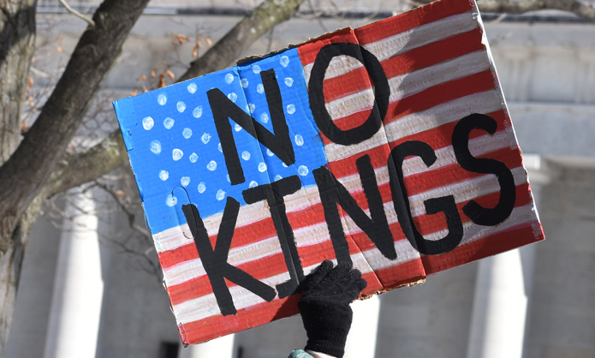
PRIVATE ENTITY DESERVE PROTECTION LIKE A KING?
Andrew also hold that “[t]he idea that the government can now enter into favorable leases and contracts based at least in part on the government’s ability to expand its umbrella of sovereign immunity to favor some private enterprises over others is an idea that warrants very close scrutiny.”
We agree. Sovereign immunity belongs to the government.
It is not a device that can be manipulated to limit the liability of a private enterprise.” (citing Univ. of Fla. Bd. of Trs. v. Morris, 975 So. 2d 493, 498 (Fla. 2d DCA 2007) (“It is obviously more economic to run any business or profession if one has limited liability. It is easier to compete with other businesses or professionals if one can avoid the costs and liabilities that the competitor cannot avoid. The idea that the government can now enter into favorable leases and contracts based at least in part on the government's ability to expand its umbrella of sovereign immunity to favor some private enterprises over others is an idea that warrants very close scrutiny.”). (EMPHASIS ADDED)

Slide 28
IS sovereign entity ACTUALLY TO BLAME OR JUST INVOLVED
Is tort the fault of a sovereign entity?
Could it be the fault of private entity?
Claims for wrongful death
  Police involved death
    Police bear any blame?
    Private entity, in fact, responsible?
    from medical facility (next topic)
  Drowning outside hotel
    Lifeguards bear any blame?
Questions:
  Defendants can Fabre government
  What was proximate cause of death?
  If not police, or lifeguards, why?
Case can become more complicated
  Sovereign immunity issues not necessarily a bar to claims, catastrophic claims deserve exploration

Slide 29
Medical malpractice
Difficulties and barriers
Tight deadlines
Presuit process can be expensive
Requirement for experts
Need for statutory survivors in wrongful death
Free kill law
Caps on non-economic damages
Arbitration request or denial
Aggressive defense counsel

Slide 30
What is a medical malpractice case? Not just any case that involves medical facility or medical professional
Deviation from a medical standard of care
Deviation results in the injury
Need to show professional relationship between patient and healthcare provider
Need to show breach of duty
Show that with expert (from same field)
Show breach of duty of care caused injury
Mean that an expert covered by Chapter 766 deviated
This breach of duty directly caused injury
Meaning, patient would not have suffered the injury if the provider had met the standard of care

Slide 31
Exceptions to Medical MALPRACTICE
Some medical professionals are not covered by Chapter 766
Out-of-state doctors not covered, must be licensed in Florida
Psychologists, therapists, or mental health counselors not covered
Certified Nurses Assistants or Behavioral Technicians are not Covered
Pharmacists not covered Cincinnati Ins. Co. v. Quorum Mgmt. Corp., 186 F. Supp. 3d 1307, 1320-1321 (M.D. Fla. 2016) (when suing a Florida licensed pharmacist, there is no need to follow the Chapter 766 pre-suit process as “the Florida Legislature simply chose to exclude them from medical malpractice presuit notice requirements.”).

Slide 32
Health care provider does not mandate med mal
Florida courts have long established that mere involvement of a health care provider does not make a case one of medical malpractice:
Nat'l Deaf Acad., LLC v. Townes, 242 So. 3d 303, 308-09 (Fla. 2018) (nurse restraining resident at Baker Act facility pursuant to plan developed by medical providers did not involve a medical standard of care because “even non-medical personnel, such as sign language interpreters” underwent this training);
Tenet St. Mary’s Inc. v. Serratore, 869 So. 2d 729, 730 (Fla. 4th DCA 2004) (patient injured during dialysis treatment at hospital is simple negligence, not medical malpractice.);
Joseph v. Univ. Behavioral LLC, 71 So. 3d 913, 917 (Fla. 5th DCA 2011) (“The fact that a wrongful act occurs in a medical setting does not necessarily mean that it involves medical malpractice.”
Robinson v. West Fla. Reg'l Med. Ctr., 675 So. 2d 226 (Fla. 1st DCA 1996) (reversing summary judgment finding assault against patient by another was claim for inadequate security, not medical malpractice);
Quintanilla v. Coral Gables Hosp., Inc., 941 So. 2d 468, 469 (Fla. 3d DCA 2006) (holding “Not every wrongful act by a medical provider is medical malpractice” and finding it simple negligence even when “nurse used her medical judgment to agree to give Quintanilla the hot tea he requested for his cough, [because] the actual act of serving the hot tea [does not] amount[] to a medical service.”).

Slide 33
Avoiding potential disputes
Maybe there is no expert possible to even hire
Can hire expert, confirm it was not deviation from standard of care
Products case: hire medical expert to determine if medical malpractice could have caused the death
Just because doctor was involved, does NOT mean it is medical malpractice, fact specific
Defense wants to blame on Med Mal: THEY now need an expert under Chapter 766 to blame it on doctor
Deviations from standard of care for a sober home, psychologist, pharmacist, CNA, you can get expert, but do not need to presuit it, because it does not fall under Chapter 766
Presuit cannot be required if there is nobody covered by Chapter 766 who can testify on issue

Slide 34
Any questions?
Aaron Clemens – Romano Law Group
aaron@romanolawgroup.com

