Slide 1
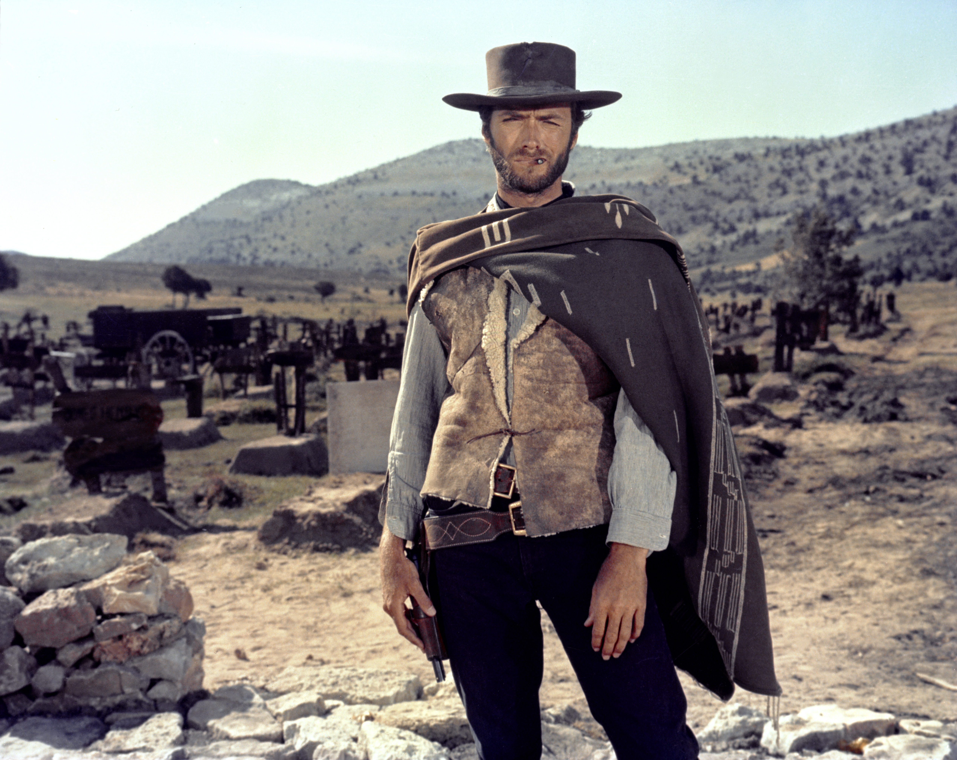
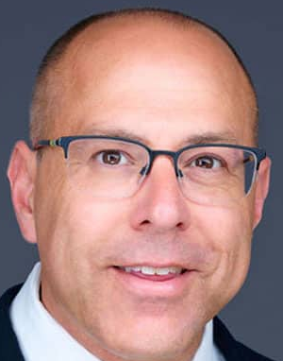
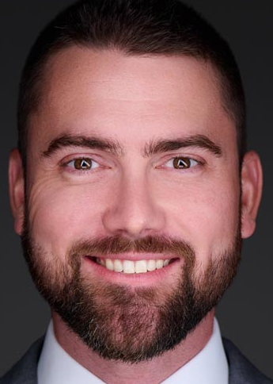
PALM BEACH COUNTY JUSTICE ASSOCIATION THE GOOD, THE BAD, AND THE UGLY: Two recent appellate decisions that will drastically impact your personal injury practice.
Presented by: Timothy (“Tim”) Kenison and Gregory (“Greg”) Cummings
March 27, 2026

Slide 2
Williams v. Leesburg Reg’l Med. Ctr, Inc. 51 Fla. L. Weekly D191(Fla. 5th DCA Jan. 30, 2026)
The appellate decision that attempts to rewrite Daubert gatekeeping analysis by flipping Daubert on its head

Slide 3
Williams v. Leesburg Reg’l Med. Ctr, Inc. 51 Fla. L. Weekly D191(Fla. 5th DCA Jan. 30, 2026)
Affirmed the striking of all four (4) of Plaintiff’s causation experts

Slide 4
Williams v. Leesburg Reg’l Med. Ctr, Inc. 51 Fla. L. Weekly D191(Fla. 5th DCA Jan. 30, 2026)
Causation issue as presented by Plaintiff and his experts:
Would the infant child have survived had antibiotics been administered on March 31, 2019 (during the last day of the first stage of pertussis), more likely than not
The infant died from pertussis (whooping cough) on April 6, 2019.

Slide 5
Williams v. Leesburg Reg’l Med. Ctr, Inc. 51 Fla. L. Weekly D191(Fla. 5th DCA Jan. 30, 2026)
How the trial court framed the issue in its Order Striking Experts:
“Here the issue is whether the delay of 12-24 hours to administer antibiotics more likely than not caused the death. The notion of early treatment is well within common knowledge that would be obvious to the average juror but has nothing to do with causation.”

Slide 6
Williams v. Leesburg Reg’l Med. Ctr, Inc. 51 Fla. L. Weekly D191(Fla. 5th DCA Jan. 30, 2026)
FN1
To clarify, in this appeal, this Court is reviewing the opinions of the experts as to whether it is more likely than not that administering antibiotics either on March 31, 2019, when A.S. was first at Hospital, or on April 1, 2019, prior to her transfer to the second hospital, would have prevented her death.
It does not consider any opinions regarding whether Appellees should have known to administer antibiotics at either point (standard of care).

Slide 7
Williams v. Leesburg Reg’l Med. Ctr, Inc. 51 Fla. L. Weekly D191(Fla. 5th DCA Jan. 30, 2026)
Two issues underlying causation:
Was the infant child in the catarrhal stage (first stage) of pertussis on 3/31?
What is the efficacy of administering antibiotics on last day of catarrhal stage in preventing death?

Slide 8
Dr. Snow (Plaintiff’s causation expert no. 3)
Board certified in pediatric critical care medicine
Treated eight to ten infants suffering with pertussis in her eighteen years as a physician, four of whom were under three months old, and only one who died.
Opined that the infant was in catarrhal stage (first stage) on 3/31 and paroxysmal stage (second stage) on 4/1
Cited medical literature that concluded antibiotics only limit the
severity of pertussis if given in the catarrhal stage (first stage)
Testified that administration of antibiotics will eliminate the pertussis bacteria in the airways of vaccinated adults within 48 hours (infant was not vaccinated)
“Because death is tied to the presence of toxins released by the pertussis bacteria, the earlier the antibiotics are administered, the more likely they are to kill the bacteria before they can produce enough toxins and have an impact on the outcome.”

Slide 9
Dr. Snow (Plaintiff’s causation expert no. 3)
She did not have any medical literature determining the
significance of a 24-hour delay in antibiotic administration on the last day of the catarrhal phase
She explained there were no studies on the impact of the antibiotics on the toxins that ultimately cause death.
“While Dr. Snow perhaps could have been cross-examined on the applicability of the cited studies on vaccinated adults to that of unvaccinated infants, the greater deficiency is that her opinion would not assist the jury in determining whether A.S. more likely than not would have survived if she had been given antibiotics on what Dr. Snow opined was the last day of the catarrhal stage of pertussis”

Slide 10
No error in concluding that Dr. Snow failed to reliably apply her method- ology to facts of the case
The appellate court concluded that “the trial court did not err in finding that Dr. Snow failed to reliably apply her principles and methods to the facts of the case in a manner that would assist the jury.”
How did Dr. Snow fail to reliably apply her principles and methods to the facts of the case in a manner that would assist the jury?
Because she only cited literature documenting that antibiotics were effective in eliminating the bacteria caused by pertussis
She did not cite any literature documenting that antibiotics were effective in eliminating the underlying toxins produced by the bacteria (it is the toxins from the bacteria that cause death)
What the opinion does not mention is that there is no literature because the efficacy of antibiotics on toxins produced by bacteria has never been studied

Slide 11
Dr. Rimawi (Plaintiff’s causation expert no. 4)
Board certified in infectious disease and critical care medicine
Treated roughly thirty pediatric patients with pertussis on an outpatient basis, with three to four fewer than six months old (although he admitted that he did not know when he was treating them that they had pertussis).
Opined that the infant was in last day of the catarrhal stage (first stage) on 3/31
Has published articles related to sepsis, treated patients for sepsis, and primarily based his opinion on medical literature related to sepsis.
(the opinion fails to mention that Dr. Rimawi writes protocols to manage sepsis in pediatrics at Emory University Healthsystem where pertussis falls under the sepsis protocol)
He believed the infant had sepsis as of 1:00pm on 3/31
Had she been given antibiotics, it would have increased her chances of survival
However, the window to administer antibiotics after sepsis is three hours

Slide 12
Dr. Rimawi (Plaintiff’s causation expert no. 4)
He admitted that he did not know the efficacy of antibiotics based upon on the particular day in the progression of the disease
He echoed the testimony of other experts that “in general earlier is better”
Dr. Rimawi could not only say survival was possible if antibiotics had been given any earlier on 4/1/19
(remember that the issue was whether the infant would have survived if antibiotics had been given on 3/31)
“The trial court did not err in excluding his [Dr. Rimawi’s] opinion either.”

Slide 13
Additional conclusion by the appellate court in Williams – trial court did not conflate the issues of # of hours without treatment with stage of pertussis
Overall, Appellant argues that the trial court improperly conflated the number of hours that passed without treatment (which he contends is not relevant) with the stage of progression A.S. was in (which he contends is). The two concepts, however, are intertwined. Depending on each expert's opinion about what stage A.S. was in at Hospital, and at what stage antibiotics would no longer affect the disease, the factfinder would have to apply the stage to the time frame to determine whether, more likely than not, if A.S. had received antibiotics at that time and in that stage of pertussis, she would have survived. While Appellant is correct that an expert does not have to establish causation conclusively to be admissible, a reasonable judge could conclude, as this one did, that the expert testimony proffered was not sufficiently reliable (Drs. Penkoske and Hull) and/or would not assist the jury (Drs. Snow and Rimawi) in determining whether a delay in antibiotics more likely than not caused A.S.'s untimely death.

Slide 14

HOW WILLIAMS FLIPS DAUBERT GATEKEEPING ANALYSIS ON ITS HEAD

Slide 15
Daubert gatekeeping analysis
1) Analysis of methodology is flexible
“Reliability is determined by examining the expert's underlying methodology rather than his or her ultimate opinion; the analysis is a flexible one…,” Williams, at p. 6 (citing Lewis v. Norfolk S. Ry. Co., 420 So. 3d 1099, 1104 (Fla. 5th DCA), reh'g denied (Oct. 24, 2025);
“The Supreme Court made clear in its Daubert opinion that the factors it set out there were not to be rigidly applied, but were instead to serve as guidelines for federal district courts applying Rule 702. The Court said, "the inquiry envisioned by Rule 702 is, we emphasize, a flexible one," Daubert, 509 U.S. at 594, 113 S. Ct. at 2797; "many factors will bear on the inquiry, and we do not presume to set out a definitive checklist or test," id. at 593, 113 S. Ct. at 2796.
,, 415 F. 3d 1257, 1267-68 (11th Cir. 2025)
Williams’ application of Daubert analysis
1) Analysis of methodology was rigid in application.

Slide 16
Daubert gatekeeping analysis
2) The absence of supporting literature goes to weight, not admissibility.
“Where an expert otherwise reliably utilizes scientific methods to reach a conclusion, lack of textual support may "go to the weight, not the admissibility" of the expert's testimony. Amorgianos v. Amtrak, 303 F. 3d 256, 267 (2d Cir. 2007). A contrary requirement "would effectively resurrect a Frye-like bright-line standard, not by requiring that a methodology be 'generally accepted,' but by excluding expert testimony not backed by published (and presumably peer-reviewed) studies." Id. (citations omitted). Such a bright-line requirement would be at odds with the liberal admissibility standards of the federal rules and the express teachings of Daubert. Id.
“[A]n expert need not back his or her opinion with published studies that support his or her conclusion if he or she has utilized reliable scientific methods to reach that conclusion.”
Coning v. Bayer Pharma AG (In re Mirena IUS Levonorgestrel-Related Prods. Liab. Litig.), 982 F. 3d 113, 124 (2d Cir. 2020).
Williams’ application of Daubert analysis
2) Methodology is unreliable without supporting medical literature
Dr. Snow’s causation opinion was excluded because “there were no studies on the impact of antibiotics on the toxins that ultimately cause deaths.`”

Slide 17
Daubert gatekeeping analysis
3) A trial court may not exclude a novel conclusion if the application of the methodology used to form the conclusion is sound. Heller v. Shaw, 167 F. 3d 146, 152-53 (3d Cir. 1999).
While ‘the focus, of course, must be solely on principles and methodology, not on the conclusions that they generate,’ Daubert, 509 U.S. at 595, a district court must examine the expert's conclusions in order to determine whether they could reliably follow from the facts known to the expert and the methodology used. Id.
Williams’ application of Daubert analysis
3) Focused on the conclusion and not the underlying methodology
“There are no concrete facts to support the conclusion. Daubert requires scientific evidence ‘fit’ the plaintiff’s theory of causation.” (citation to the lower court’s order excluding experts in Williams).

Slide 18
TAKEAWAY - EXCEL AT BOTH HIRING THE RIGHT EXPERTS AND PREPARING THEM FOR DEPOSITION
Make sure your expert can explain his or her opinions in clear, simple terms (simplicity leaves no room for conflation)
If there is no literature to support the opinion, the expert will need to be prepared to explain why
If necessary, clarify your expert’s opinions on cross before concluding the deposition

Slide 19
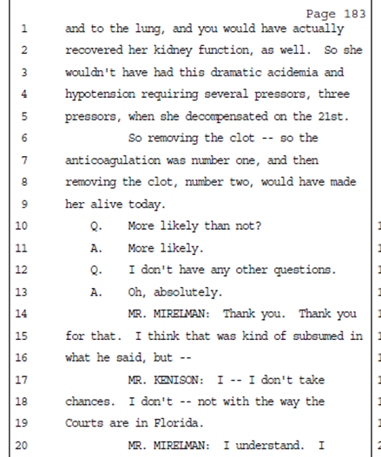
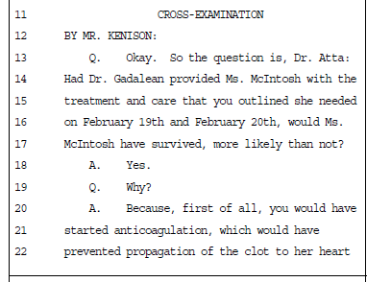
TAKEAWAY - Clarify your expert’s opinions on cross before concluding the deposition if you feel its necessary

Slide 20
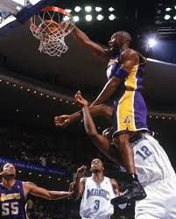
DO YOUR BEST TO REMOVE ANY OPPORTUNITY FOR OPPOSING COUNSEL TO CONFLATE THE ISSUE

Slide 21
Crecelius v. Rizzitano, No. 6D2024-2217, 2026 WL 555031 (Fla. 6th DCA, Feb. 27, 2026)
The Florida Supreme Court issued its decision in Binger v. King Pest Control in 1981. 401 So. 2d 1310 (Fla. 1981).
Since Binger was decided, our fellow district courts have misapplied the opinion in a manner that has severely
hampered the ability of trial judges to effectively manage civil lawsuits and accomplish the primary goals of our civil
discovery rules — to prevent surprises at trial and to assist in arriving at the truth. This opinion explains where
our sister courts went wrong on Binger.

Slide 22
Crecelius v. Rizzitano, No. 6D2024-2217, 2026 WL 555031 (Fla. 6th DCA, Feb. 27, 2026)
The expanded holding in Binger v. King Pest Control, 401 So. 2d 1310 (Fla. 1981) cannot survive Rule 1.200’s mandate that “deadlines in a case management order must be strictly enforced unless changed by court order. Fla. R. Civ. P. 1.200(e)(1).

Slide 23
The Sixth District is inviting trial attorneys to look at intermediate appellate(DCA) decisions interpreting FSC opinions skeptically
The Sixth District concluded in Crecelius that intermediate district courts for the past 45 years have expanded Binger beyond its holding

Slide 24
The Sixth District is inviting trial attorneys to look at intermediate appellate(DCA) decisions interpreting FSC opinions skeptically
Intermediate appellate courts have treated the Supreme Court's statement [in Binger] — that if the trial court finds that the undisclosed witness will not prejudice the other party after considering the factors listed in Binger, then the witness should be allowed to testify — as a binding holding.

Slide 25
Determine the case holding
“The holding of a case ‘consists of those propositions along the chosen decisional path or paths of reasoning that (1) are actually decided, (2) are based upon the facts of the case, and (3) lead to the judgment.’” Pedroza v. State, 291 So. 3d 541, 547 (Fla. 2020) (citations omitted).
"Any statement of law in a judicial opinion that is not a holding is dictum.”
“While we are bound to follow all holdings of the Florida Supreme Court, we are not bound by dicta contained in the Supreme Court's opinions.”

Slide 26
What is Binger’s holding under Pedroza analysis?
Applying the framework set forth in Pedroza, the Supreme Court's statement in Binger — that if the trial court finds that the undisclosed witness will not prejudice the other party after considering the factors listed in Binger, then the witness should be allowed to testify — was dictum.
The facts of Binger were that the trial court allowed the plaintiffs to introduce testimony from a witness that the plaintiffs failed to disclose by the deadline set forth in the pretrial order. The Florida Supreme Court found that the defendant was prejudiced by the testimony of the undisclosed witness.
The issue actually decided in Binger — based upon its facts — was that the trial court should not have permitted the plaintiffs to introduce the undisclosed witness's testimony where the defendant would suffer prejudice from the undisclosed witness's testimony.

Slide 27
The Sixth District is inviting trial attorneys to look at intermediate appellate (DCA) inter-preting FSC decisions skeptically
In sum, Binger concerned undisclosed witness testimony that was improperly allowed and should have been excluded due to prejudice to the other party.
Binger did not concern undisclosed testimony that was improperly excluded or what the trial court should have considered before excluding undisclosed testimony.
Thus, per Pedroza, the holding of Binger is that where a party fails to disclose a witness by the deadline set forth in a pretrial order, the trial court must consider prejudice to the other party before exercising discretion to allow the testimony.
The Supreme Court's statement about what a trial court should consider before excluding an undisclosed witness’s testimony was pure dictum. Nothing about this statement led to the judgment in Binger and it is, therefore, not binding on this court or on trial courts.

Slide 28
Why Binger is on life support
Under Binger’s expanded holding, appellate courts would reverse and remand cases if the trial court ruled on a Binger motion to exclude without considering prejudice the other party.

Slide 29
Why Binger’s expanded holding is incompatible with Rule 1.200(e)(1).
Simply put, the combination of these two expansions of Binger have made it extremely difficult for trial courts to enforce their pretrial orders in order to effectively manage civil lawsuits and prevent trial by surprise.
Under Binger as interpreted by our sister courts, anytime a party fails to disclose a witness or a change in a witness's testimony by the deadline set forth in a pretrial order, the trial judge cannot enforce the pretrial order and exclude the undisclosed testimony without first finding that the opposing party was prejudiced by the failure to disclose.

Slide 30
Why Binger’s expanded holding is incompatible with Rule 1.200(e)(1).
Rule 1.200(e)(1) eliminates the requirement that the trial court find prejudice to the opposing party before it may exclude the witness.

Slide 31
Binger’s expanded holding ignores the part in Binger where it states “pretrial orders must be strictly enforced”
Thus, the Florida Supreme Court expressly stated in Binger that trial courts can issue pretrial orders that prohibit the introduction of testimony from undisclosed witnesses, that such orders "in no way derogate from" the Binger decision, and that these orders, among other local case management practices, "can and should continue."
It cannot be the holding of Binger that pretrial orders prohibiting the introduction of testimony of undisclosed witnesses cannot be strictly enforced when Binger explicitly states that such orders can be enforced.

Slide 32
Rule 1.200 is patterned from F.R.Civ.P. 16 so move to modify pretrial deadlines as soon as you have “good cause”
Must show “good cause” to modify pretrial deadlines
This requires a showing that the party cannot meet deadlines despite diligence of the party seeking the extension
Scheduling orders "control the subsequent course of the action unless modified by a subsequent order," Fed.R.Civ.P. 16(e), and may be modified only "upon a showing of good cause." Fed.R.Civ.P. 16(b). This good cause standard precludes modification unless the schedule cannot "be met despite the diligence of the party seeking the extension." Fed.R.Civ.P. 16 advisory committee's note; see also Johnson v. Mammoth Recreations, Inc., 975 F.2d 604, 609 (9th Cir.1992) ("If [a] party was not diligent, the [good cause] inquiry should end.").
Sosa v. Airprint Sys., 133 F. 3d 1417 (11th Cir. 1998)

Slide 33
Why Binger is incompatible with Rule 1.380(d)
Under Rule 1.380(d), as amended, "[i]f a party fails to provide information or identify a witness as required by rule 1.280(a) or (g), the party is not allowed to use that information or witness to supply evidence on a motion, at a hearing, or at a trial, unless the failure was substantially justified or is harmless."
Thus, for undisclosed witnesses or evidence falling within the scope of Rule 1.380(d), a trial court now must exclude the evidence unless the failure to disclose was substantially justified or . . . harmless." This is a significantly different standard than determining whether the other party would suffer prejudice under Binger.

Slide 34
Rule 1.380(d) is patterned from F.R.Civ.P. 37(c)
In evaluating whether the district court abused its discretion in excluding the testimony of a late witness under Rule 37, we consider: (1) the importance of the testimony; (2) the explanation for the failure to disclose the witness; and (3) the prejudice to the opposing party if the witness had been allowed to testify. (internal citations omitted). We've held that the second and third factors, "together, can outweigh" the first. Id. In this case, the district court also considered a fourth factor -- the availability of a continuance to cure any prejudice caused by Scott's failure to disclose. (internal citations omitted). Courts have broad discretion to exclude untimely expert testimony.
Scott v. Carnival Corp., 2025 WL 2402001 (11th Cir. Aug. 19, 2025)

Slide 35
A calendaring mistake is neither good cause nor substantially justified, as per Crecelius
“Defendant filed a response which explained that the expert witness list had been filed late because of internal office mismanagement by Defendant's counsel.”
“The trial court concluded that Defendant's reasons for the late disclosure did not excuse the untimeliness, and that
the circumstances of Defendant's noncompliance with expert disclosure deadlines were egregious.”

Slide 36
Fin.

