Slide 1
Fighting Billing/Coding Witnesses From Initial Discovery to Closing Argument

Slide 2
Summary
Billing/Coding witnesses are utilized for the very specific purpose of conducting a “kitchen sink” defense – that is when all else fails, throw everything at the Plaintiff. The idea generally is that the Defense is in a bad place on liability and therefore leans entirely into the other portions of the VF;
Consider that this means that the Defense is trying to backdoor inadmissible evidence into trial when they know their client is at fault and that your client is hurt as a result. Priority #1 is to strike the billing/coding witness before they can mislead the jury and harm your client (unless you shouldn’t);
The battle to strike the billing/coding witness begins early on in your case, can generally be simply replicated once the process is mastered, and the witness can still be capably cross-examined at trial and his/her true purpose unveiled in closing arguments if the Court rules incorrectly on Daubert.
Half the battle, as with all things in life, is preparation. Fight the battle early, often, and throughout.

Slide 3
Getting Ahead of the Potential Billing/Coding Defense Tactics

Slide 4
The Plaintiff and the Plaintiff’s Case
The questions you must ask at the beginning of your case:
  What facts are at your disposal?
    Course of treatment your client has endured;
    Difficulties being faced by your client (physically and financially) due to injuries sustained;
    Available avenues through which the client can receive treatment (VA, Medicare, LOP).
  Who is your client?
    How might the client’s work history, family history, past medical conditions and incidents, aversion to certain types of treatment, etc. impact their medical choices.
  Who are the treating doctors in the case?
    What are their qualifications? Educationally, professionally, in their capacity of publishing and of educating other doctors.

Slide 5
Facts At Your Disposal
Plaintiff’s Deposition:
  Make sure that the Plaintiff mentions in their deposition how they feel about needles, surgery, or about any reason they themselves may be leery of the medical profession or medical treatment;
  The Plaintiff’s pain and suffering damages are helpful here as well – how much suffering does a person have to endure before surgery becomes a necessity and how does a billing/coding witness determine what the value of that compromised decision is?
  Be prepared for arguments concerning how payment was made for treatment and ensure that discussion regarding how the incident has impacted payment ability is had on the record;
    Veteran – challenges with VA treatment if the client did not treat through the VA;
    Medicare – the Plaintiff is uncomfortable with available options;
    Plaintiff is from another state or country and therefore unfamiliar with the area or how to get covered.

Slide 6
Who Is The Plaintiff?
Flesh out relevant work history, your client may have worked in relevant fields (medical, billing, military);
Many clients have family members or friends who had very negative experiences with the medical profession or were victims of medical malpractice;
The Defense loves to try to make every case about “priors”, do not run from this but rather lean into it even in the billing/coding context;
Nearly the entire public has reservations concerning certain or all modalities of medical treatment;

Slide 7
Who Are the Plaintiff’s Treating Medical Providers?
The qualifications of the treating doctor are of critical importance:
  Are your client’s medical providers Ivy League-educated?
  Many doctors teach other doctors how to perform medical procedures that your client has endured due to the Defendant’s negligence – make sure this becomes known in a deposition then use that to attack the billing/coding witness;
  Many doctors are known for publishing or being thought leaders, weaponize this information for the plaintiff’s benefit.

Slide 8
Defense Disclosed A Billing/Coding Witness – Where Do We Begin?

Slide 9
First Steps When Defense Discloses a Billing/Coding Witness
At the time of disclosure of a billing/coding “expert”, there are a few simple steps to follow initially that will make life easier down the road:
  Set aside a half hour on your calendar to complete a cursory search of the witness (are they a nerd (good), a faux medical expert (bad), or a mercenary (ugly)?);
  Immediately send out initial expert discovery requests – do not waste time, having the witness’s sources as soon as possible is the single most important thing you can do to protect your case (craft your discovery in case there isn’t a report – but there will be, they cannot help themselves);
  Set the deposition of the witness (with a back-dated duces tecum or RC deposition in advance) but be very careful to give yourself time to get the information you need and to force the issue if necessary; and
  Scour the planet for any orders limiting testimony or striking the witness – listservs, expert outlets, etc. We all know these are helpful for any expert but they take on particular importance with billing/coding witnesses.

Slide 10
The Report and What Really Matters
The Credibility and Reliability of the Source Materials

Slide 11
The Good (Nerd), the Bad (“Medical Expert), and the Ugly (Mercenary)
No matter the genre, I am always sincerely polite with the expert in the early going. Review the CV and neutralize any threats in the CV early on when things are still largely pleasant. Do not run from these things, hit them head on. There are generally three kinds of billing/coding witnesses:
  The Nerd – at best a professor somewhere but someone who loves coding with all their heart:
    These are “the good” because they generally are married to their sources and sometimes do not understand the damage they are being asked to do to victims of negligence. (Use)
  The Medical “expert”: sometimes you will draw a witness who fancies him/herself a medical expert because they were a nurse or because their name is Michael Zeide:
    Usually they back off of this quickly, if they do not then attack this throughout the methodology portion of the deposition. (Neutralize)
  The Mercenary you will often know on sight:
    Finding material on them will not only be easy, the Daubert motion will largely write itself;
    If they have been stricken many times before, they may see it coming - I prefer not to tip them off. (Phone friends)

Slide 12
Source Materials and Databases
Use every fact and weapon at your disposal to discredit the faulty source materials and databases – this is the whole shooting match:
  Most witnesses have multiple sources (PMIC, Context4HealthCare, Milliman, VA, etc.) and some (Bonaparte) will state that they cross-checked these against each other;
  Go to their sites and get as much ammunition as you can generally;
    How do they market themselves? How do they claim they are verified? Who is on their management team?
  Determining where their data comes from is the key
You must have the witness’s entire file at least 72 hours prior to deposition, no exceptions, and ideally a week prior (use the DCMO and FSC rules to your benefit).

Slide 13
The Report and Tables
Though I usually spend 10 minutes on this part of the deposition, you should review the report in detail prior to. The primary reasons for this, for me, are:
  Look for completeness (do they have all the bills);
  Sound bites;
  Errors (did they properly code the treatment, missing providers/treatment);
  Correct years of sources corresponding with treatment;
  How much of the total bills are being alleged as coding errors; and
  It is important to know just how unreasonable their findings are and which percentiles they use.
However, for me this information is contextual though I have seen great work done by other lawyers regarding the actual contents beyond what I do.
Once you have spotted all of the above, make sure to commit the witness to their ultimate numbers.

Slide 14
Taking The Deposition of the Billing/Coding Witness
You’ve Heard of “Getting To Yes”, Now You Will Learn How to Get to “No”

Slide 15
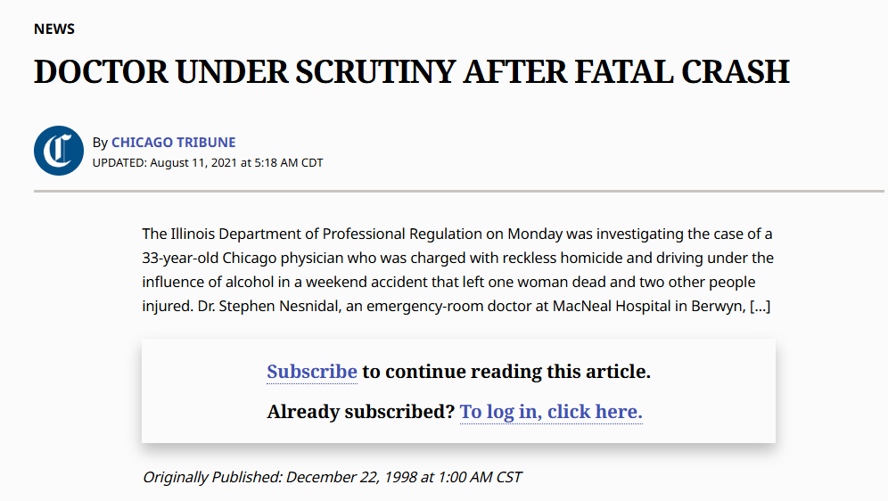

Slide 16
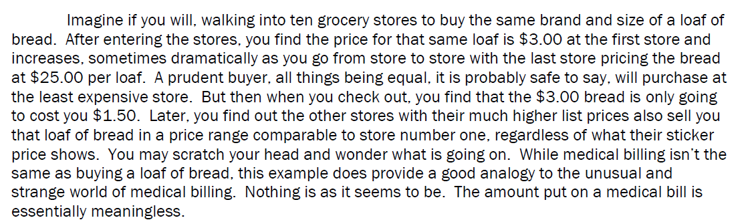

Slide 17
Structure of Your Discovery Deposition – Whittle Down The Witness
Qualifications (~10 minutes):
This should not be a huge part of your deposition, it should serve the following Trojan Horse purposes:
  Easing your witness into the deposition – kill with kindness early on;
  Getting your witness comfortable before you move on to methodology;
During the background stages, you should already have identified particulars in the witness’s CV that need to be neutralized:
  Was or is the witness a nurse (and what/when/where)?
  Has the witness done any work in this field outside of litigation or the defense industry?
  Ask about equity/ownership in any entity at any time.

Slide 18
Methodology – Where the (Boring) Magic Happens
This is the critical point of your deposition of the billing/coding witness (~45 minutes):
This portion of the deposition should always begin by naming the sources on which the witness relied – do not let the expert off the hook with any wishy-washy language. None of the following are acceptable:
  “That I can recall right now…”
  “I may have used others, I am not sure off the top of my head…”
  “I may have learned others during training that were helpful to me here that I cannot think of right now…”
Commit the witness to their entire list of sources and do not back down until you have them – if they try to “knowledge, training, and experience…” the question, tell them you need specifics and sources. THE WITNESS IS A CONDUIT TO HEARSAY AND NOTHING MORE, PROVE IT.
Once they have given you the list, it is time to move into committing them to their hearsay.

Slide 19
Commit the Witness to Their Sources
Once the witness has given you the sources, you should ask a question something like:
  “Alright, and you would agree with me that you are determining the UCR rates for my client’s medical treatment based on the verified billions of charges contained in the Context4HealthCare database?”
    If they fight this, do not back down – ask where else/how
  “So the UCR rates in your opinions come from Context4HealthCare’s database?”
  “Your testimony is based largely on what Context4HealthCare’s database contains?”
  “You trust Context4HealthCare because you trust their methodology and information?”
  “The data in your 12 page report in which you give your opinions for what the UCR of my client’s treatment to be are based entirely on what Context4HealthCare’s database states?”
You may or may not realize it but at this point, you have won the war if you stick the landing by committing them to their methodology from here on out.

Slide 20
How The Billing/Coding Witness Packages The Hearsay
This part of the deposition should begin with a question that sounds like the following:
  “I appreciate that this is going to be arduous and time-consuming, but I need to know each and every single step in your process of reaching your opinions as to my client’s medical bills in this case from the moment you are retained until the moment that you reached your final opinions. Please begin.”
Once the witness begins, you will stop and ask questions about each step – deliberately get the witness lost in the minutia of their own process.
  Computer software? Any other people assist in the process? Purchase of subscription?
Always circle back and use the same language: “Okay, we got a little in the weeds there sorry about that. Have we covered that step of your methodology completely? Is there anything else we need to cover about that step? Good – so after you review the medical charges, what is the very next step?”
Remember that they usually love this and that you already have them committed to their hearsay. Also keep in mind that their “methodology” amounts to little more than the equivalent of a narrowed down Google search.
While you are going through this process and committing them to their “methodology” you will begin to realize that the witness is very comfortable with what is occurring – they probably like you and think you find their job to be very interesting. You will likely come off like someone trying to learn as much as you can about their job.

Slide 21
Where the Deposition Becomes Fun – Attacking the Methodology and Sources

Slide 22

Witness Committed, Target Acquired, Press the Red Button
Keep in mind the following:
  The witness should now be married to their sources, there is no pulling back without discrediting themselves;
  The witness is now also married to their methodology – if they try to add steps, make sure to commit them to that and ask where in their methodology that new step fits, they will not know and it will illustrate that their methodology is a sham;
  The witness is comfortable with you – ease into the tough questioning then go nuclear once you have asserted control.

Slide 23
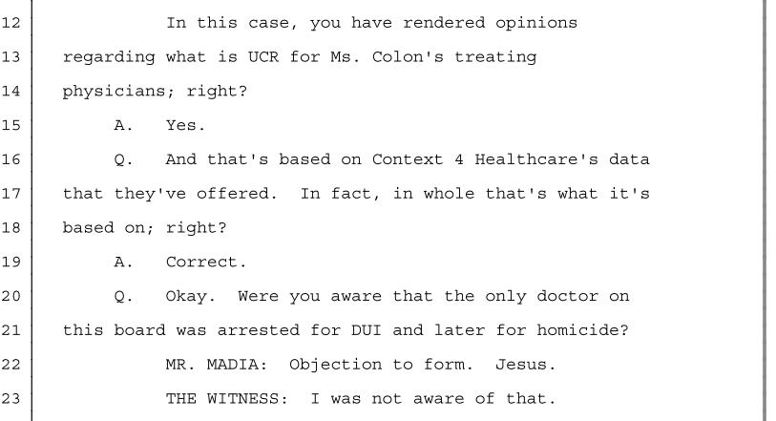

Slide 24
Peppering the Witness with Daubert Prong Questions
“I have just a few questions for you about your methodology in this case”
Two-Factor Authentication Style Daubert – make this work at both the expert level and then the data level:
  Whether it has been tested and can be tested;
    Have you tested your methodology before to see if it is accurate? (HUH) Well have you ever taken your methodology, outside the litigation context and tested it to make sure it is accurate? Your numbers come from Context4HealthCare, right? So you would have to test their methods to ensure yours is correct? Have you verified it with doctors? Verified it with other billers/coders? Have you ever gone to your sources and checked with them to make sure their numbers were correct? Ever called them to cross-check it?
    Right - the data is correct, so you feel your method is correct? You feel that C4H is reliable?
    Do you know if Context4Healthcare tests the reliability of their data/charges? Do you know who provides those? These are all health insurance, correct? So, again relying only on what C4H is telling us, their charges come from health insurance providers who have bills from doctors but no other doctors?
  Whether it has been subject to peer review and publication;
    Do you in your practice work directly with any other billing/coding experts and look over each other’s work sometimes? Same question – but regarding your methodology we have been talking about, no one checks over that generally speaking? Alright, so fair to say you did not have anyone check your work in this case? No peers reviewed your work?
    Do you know how Context4Healthcare verifies the accuracy of their data? Do you know if they do so regularly? How regularly? How do you know that? Because they say they do, correct? Do you know of anyone over at C4H whose job it is to verify their data? So you do not know their qualifications? Do you even know if there is a specific person who does this? Do you know if they bring in a third party to audit? Who that is?

Slide 25
Peppering in Daubert Prong Questions (Part Deux)
Two-Factor Authentication Style Daubert – make this work at both the expert level and the data level (cont’d):
  Known of potential rate of error:
    Do you know what the rate of error is for your methodology? Do you know if there is a rate of error? Do you specifically know if there is a rate of error for the work you did in this case?
    But you do feel that C4H is a reputable source and therefore you are comfortable in this regard?
    What is the rate of error for C4H’s data set? Your opinions in this case come from their database, right? So what is the rate of error of their data set?
  Existence and maintenance of standards or controls:
    Is your work standardized? Is there a means through which you ensure uniformity of your methodology across cases?
    C4H – same questions, they will not know the answers. They cannot know – oftentimes it is proprietary, trade secret.
  Whether it has attracted widespread acceptance within a relevant scientific community;
    Ask for specific people or organizations – they use this as well? Do you know if they base their methods off of C4H or similar sources?
Go through each with the expert to confirm for their sources, additionally ask if they know who we can reach to discuss each. Do not back down for even a moment, always follow up and always be confident that the witness very likely will run out of rope.
Assuming I have the correct codes for my client’s treatment and I have a subscription with C4H, is there any reason I would be unable to do what you did to reach your opinions? Same question – but for a member of our jury? ChatGPT? Database?

Slide 26
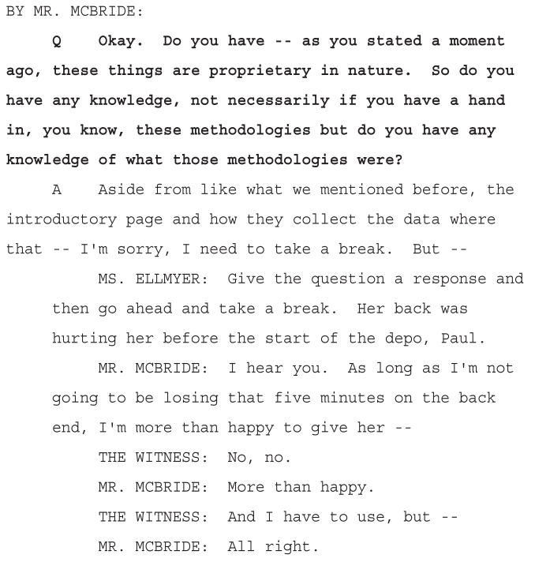

Slide 27
Pressing the Red Button – Lines of Attack that Demonstrate How Unusual, Uncustomary, and Unreasonable the Opinions Are

Slide 28
Discussion of the Client and Treatment (Part 1)
Draw out the contrasts to lethal effect and why it is that the witness’s lack of knowledge of the sources is so important. This is where you inject into the deposition the client’s specific background, the particulars of the treatment, and the qualifications of the treating providers:
  Trust between a doctor and a patient is important (facilities, wait times, staff, reviews), no?
  The witness is nearly never aware of the qualifications of your client’s treating providers – use this fact and use examples.
    Would you agree that a Harvard Medical School trained surgeon would likely charge more for their work than a Western University trained surgeon?
  “You do not know the identities of any medical providers in C4H’s database, correct? You would agree with me that a fundamental aspect of how medical patients choose a doctor would be the qualifications of their doctor? (Education, training, experience)”
  They use a geographical tracker for the area in which the patient treated – lean into this rather than recoil:
    LOP vs. other treatment (did not account for this in the data set and apply to the case)
    Did you speak to any doctors in the Palm Beach County area in reaching your opinions?
    Did you speak to my client’s doctors or their offices before this deposition?
    Have you ever been to Palm Beach County, Florida?

Slide 29
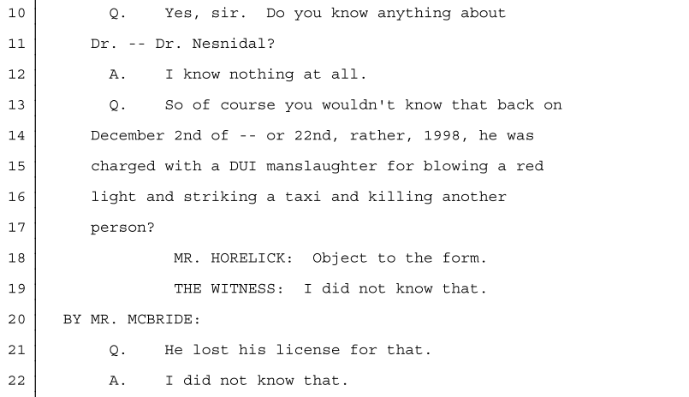

Slide 30
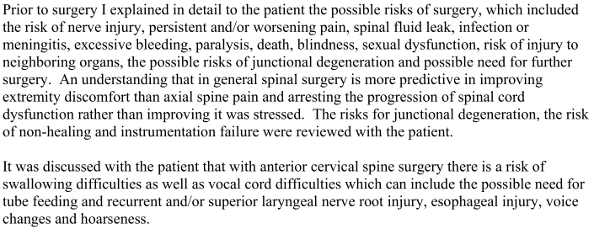

Slide 31
Discussion of the Client and Treatment (Part 2)
At the beginning of the deposition, you already obtained a list of EVERYTHING the expert reviewed to reach their opinions
  “You were not provided with my client’s deposition to review, correct? So you are not aware that my client mentioned four times in his deposition that he is afraid of needles? He had 5 epidural steroid injections, right? How do you determine what the value to a patient is of overcoming a fear of needles in order to treat pain? C4H does not to your knowledge account for the value of the doctor-patient relationship in its data, correct?”
    Age, family history, phobias
  “You are not aware of the fact that my client fears medical treatment because she feels that her cousin nearly died due to medical malpractice? On that point, you do not know the identities of any of the doctors who submitted charges that were later collected by C4H?”
  Rip through medical malpractice – are you aware that according to various estimates, anywhere from 40,000 to 200,000 people die in this country every year due to medical malpractice? Is it not true that you have no idea if any of these charges in the C4H database came from doctors who have actually negligently killed a patient? There are billions of charges though, right? So someone in there killed someone? Any idea how many?
    https://www.ncbi.nlm.nih.gov/books/NBK499956/

Slide 32
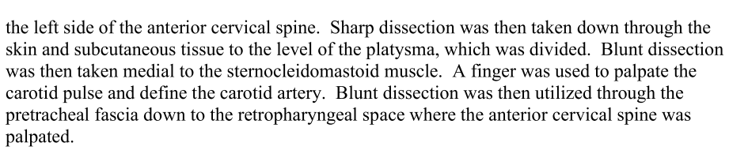

Slide 33
Discussion of the Client and Treatment (Part 3)
Importance of medical history and complexity of the client’s treatment:
  “You are not aware that my client has a complicated medical history? They were high risk for surgery as a result but still chose to take the chance in order to try to lead a normal life again?”
  Are you familiar with what an ACDF is (22551/22552)?
    Anesthesia;
    Transverse Incision;
    Palpation of the carotid artery;
    Fusion of vertebrae;
    Intraoperative X-Ray;
    Risk of injury to the laryngeal nerve;
    High speed-burrs;
    Metal Cage placed in the client;
    Sculpting of the bone in a patient (ALIF);
    Preventing postoperative hematomas.
    Do you know if C4H took this into account? (“Well they used billions of charges, the average accounts for that by default” – according to C4H themselves, correct?)
    *Use Imagery*

Slide 34
Drafting the Daubert Motion

Slide 35
Marshalling the Facts to Your Favor
There should be three separate arguments in descending order of importance:
  Conduit to Hearsay:
    Largely in reference to the sources and the witness’s complete reliance upon them but also utilize Daubert here;
  Daubert Prongs Analysis (remember that the burden is on the proponent to establish admissibility by a preponderance of the evidence):
    All about the witness himself/herself and their methodology which is simply reading a publication and then creating a report;
  Coding references are a collateral attack and inject insurance into trial:
The facts are critically important and should constitute a wrecking ball in your motion:

Slide 36
Wield Orders To Devastating Effect
The language in your Daubert motion regarding Prior Orders Limiting/Striking Testimony should be crafted to show your judge the witness does not respect judges or the rule of law:
  “Not only are the Orders attached hereto as Exhibit “C” deeply alarming as it pertains to Ms. Bonaparte’s methodologies as a general matter in light of the fact that it evinces the deep lack of faith in Ms. Bonaparte’s methodologies by jurists of so many jurisdictions across so many years – these Orders are also direct evidence that Ms. Bonaparte knows her methodologies are not trusted by the judiciary and yet Ms. Bonaparte has taken no measures to shore up her practices as she openly admits and testified in the instant case. (Bonaparte Dep. 77:4-11). Ms. Bonaparte at no time in the five years prior to her deposition in this matter (taken on April 24, 2023) ever modified or updated her methodologies. (Bonaparte Dep. 78:3-13).”
  “As if the contents of the foregoing two paragraphs are not themselves concerning, Ms. Bonaparte’s testimony was stricken multiple times in the years 2021, 2022, and in the shortly more than three months of 2023 preceding her deposition. In fact this had occurred several times, including within days of her testimony in the instant case.”
  “Simply put, it is stunningly difficult to believe that Ms. Bonaparte’s lack of knowledge of these orders at the time of her April 24, 2023 deposition in the instant case was remotely credible.”

Slide 37
Case Law In Addition to Daubert
Regarding the billing/coding witness being a conduit to hearsay:
  Hayes v. Walmart Stores, Inc., 933 So.2d 124 (Fla. 4th DCA 2006) (Holding "inadmissible facts or data may not be introduced through the direct testimony of the expert. Under such circumstances. the expert may not be used as a conduit for the admission of evidence.");
  King v. Auto Supply of Jupiter, Inc., 917 So.2d 1015, 1018 (Fla. 1st DCA 2006) (Ruling that an expert is permitted to rely on inadmissible evidence, the information supporting the opinion must still be trustworthy);
  Liberatore v. Kaufmann, 835 So.2d 404 (Fla. 4th DCA 2003) (holding that an expert may not rely on a treatise or publication in direct examination to support an opinion);
  Jordan v. State, 694 So.2d 708 (Fla. 1997) (although an expert may be qualified to express an opinion based on knowledge gained through a review of the relevant authoritative sources, the witness cannot express an expert opinion when the record did not demonstrate a sufficient study of the scientific literature);

Slide 38
Questions to Ask Yourself and Lines of Questioning for Trial

Slide 39
Questions for Counsel
Do I actually want to strike the witness based on the facts of my client’s case?
Should I stipulate to the amounts of the alleged coding errors?
How do I best combat the billing/coding witness throughout the entirety of trial?
  Voir dire – “Who here has had family who had a negative experience with their medical care?”;
  Opening Statement – The Defense will acknowledge they hurt Ms. Smith but then tell you they should not have to give back what they took away from Ms. Smith and one of those ways they are going to try to avoid responsibility is by having a witness tell you everyone’s medical care is the same, should be charged at the same rate, and that the medical bills should not be paid.”;
  Tie this all together in closing argument as an attack on the sanctity of the doctor-patient relationship, a “one size fits all” approach to medicine (consider going borderline political based on jurisdiction and your jury – “top-down” “government”)
  “The Plaintiff was willing to pay ________________ to live a normal life again, to some that may seem unreasonable but for this person that was the price paid for what the Defendant took from her”

Slide 40
Other Lines of Questioning at Trial
Conduct a comparison of the hourly rate the billing/coding witness is being paid versus what the witness is claiming the surgeon should be paid;
Hammer home that the client has to pay the bills no matter what (and make sure this comes out in testimony);
Utilize the client’s testimony regarding why they chose their doctor in the first place and how important that choice was to him/her;
  Make sure your client has expressed their fears and phobias to their doctor as well as their medical history
Conduct a “soft cross-examination” on your treating doctors in their testimony concerning why their bills are what they are;
  “We do not believe in “one size fits all” medicine at my practice and this patient has __________ medical history that made this procedure even more complicated”

Slide 41
Questions?
Reach me with requests for materials anytime:
pmcbride@goldlaw.com
(561) 228-1589

