Slide 1

Andrew A. Harris
Harris Appeals, P.A.
Board Certified in Appellate Practice
(561) 867-9500 andrew@harrisappeals.com
Annual Overview of Proposals for Settlement and Demands for Judgment
PBCJA Webinar
April 25, 2025

Slide 2
Test time for everyone
One Plaintiff vs. One Defendant.
Plf. to Def. Proposal for Settlement (PFS) for $1 million.
Missing information here:
How much insurance coverage is there?
Is the defendant independently wealthy?
Payment terms?

Slide 3
Test time for everyone
One Plaintiff vs. One Defendant.
Plf. serves to Def. a Demand for Judgment [DFJ] for $100,000.
There is $1 million in insurance coverage.
A DFJ doesn’t have to consider the ability to pay, or when to pay.
A Demand for Judgment is a demand for a ….. Judgment.
If accepted, you are entitled to a piece of paper, a Judgment.

Slide 4
Test time for everyone
One Plaintiff vs. Two Defendants.
Plaintiff serves a PFS to the Defendants for $100,000.
If accepted, Plaintiff will dismiss all claims with prejudice.
There is a $1 million dollar insurance policy.
We are missing a critical fact here to know if this is valid.
What is the relationship between the two Defendants?
If you alleged direct liability against both Defendants, this is invalid.
When you have direct theories against each Defendant, you must serve stand-alone, independent offers in all scenarios outside of a limited property insurance exception expressly now written into 768.79.

Slide 5
The Rule 1.442 Exception
Rule 1.442(c)(4): The Vicarious Liability Exception
  (c)(3) A proposal may be made by or to any party or parties and by or to any combination of parties properly identified in the proposal. A joint proposal shall state the amount and terms attributable to each party.
  (c)(4) Notwithstanding subdivision (c)(3), when a party is alleged to be solely vicariously, constructively, derivatively, or technically liable, whether by operation of law or by contract, a joint proposal made by or served on such a party need not state the apportionment or contribution as to that party. Acceptance by any party shall be without prejudice to rights of contribution or indemnity.
The allegations of the Complaint control. You must solely allege one Defendant is faultless to be able to serve a PFS to 2 Defs. Examples: Car Owner is liable just for owning the car where a permissive user causes an accident; or an Employer is liable just for employing its negligent employee.
The issue isn’t whether defendants are liable for the same damages, but whether there are active negligence claims against both defendants.

Slide 6
Test time for everyone
One Plaintiff vs. Two Defendants. Walmart and its Store Manager.
Plaintiff serves a PFS to the Defendants. Of the total amount, $90,000 paid by Walmart, $10,000 paid by the store manager.
Is this valid?
No, no, and no.
First, you haven’t been given the facts regarding Walmart. If alleged to be directly liable, you cannot serve an offer to multiple defendants.
Second though, in the one scenario when you can serve an offer to multiple defendant recipients [the Rule 1.442 faultless liability exception], it is for one total sum of money.

Slide 7
Test time for everyone
One Plaintiff vs. Two Defendants. Walmart, for vicarious only, and its Store Manager.
Plaintiff serves a PFS to Walmart for $100,000.
If accepted, the Plaintiff will dismiss all claims with prejudice against both Defendants.
Is this valid?
No, no, and no.
This is a term not allowed since the 2022 rule change. This has nothing to do with the relationship between the defendants, the amount of the offer, whether it is a PFS or DMJ.
You have included a non-monetary term. Almost all non-monetary terms are prohibited.
Note: could you have served an offer to both Defendants here?
Yes, for an unallocated amount, since you solely alleged faultless liability against Walmart.

Slide 8
Test time for everyone
Two Plaintiffs vs. Defendant.
Plaintiffs serves a PFS to Defendant of $100,000. If accepted, the Plaintiffs will dismiss their claims against this Defendant with prejudice.
There is a $1 million dollar insurance policy.
Is this valid?
The rules on the offeror side are different than the recipient side.
Multiple offerors can always serve a joint offer.
But the joint offer must be allocated, so here, each Plaintiff must have allocated a portion of the total offer.
Beware the math issue with serving a joint, allocated offer.

Slide 9
Test time for everyone
Two Plaintiffs vs. Defendant.
Plaintiffs serves a PFS to One Defendant of $100,000. Of the total amount of $100,000, Mr. Plaintiff will receive $40,000, while Ms. Plaintiff will receive $60,000.
If accepted, Plaintiffs will dismiss this action with prejudice.
There is a $1 million dollar insurance policy.
This is technically valid.
The math issue: To recover any fees, both Plaintiffs must beat their allocated amounts by 25% or more. Hoang Dinh Duong v. Ziadie, 153 So. 3d 354 (Fla. 4th DCA 2014).

Slide 10
The math issue with joint offers from multiple plaintiffs
The math issue when two or more plaintiffs serve a joint, allocated offer: To recover any fees, each of the Plaintiffs must beat their allocated amounts by 25% or more. Hoang Dinh Duong v. Ziadie, 153 So. 3d 354 (Fla. 4th DCA 2014).
In that case, a global, allocated PFS was serve by 3 Plaintiffs. Each beat their respective amounts by 25%+.
In dicta, the Fourth DCA explained that the only way for any Plaintiff to recover fees is if all plaintiffs beat their respective amounts by 25%+.
“if the verdict for any of the claimants was not twenty-five percent higher than the amount of the claim in the settlement proposal, then none of the claimants could obtain attorney’s fees under its terms.”

Slide 11
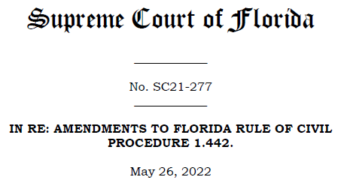

Slide 12
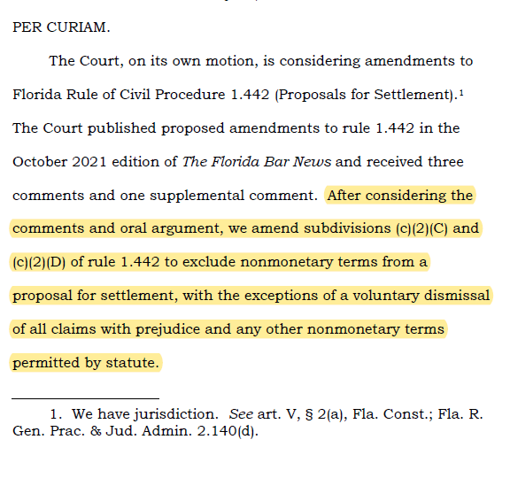
The Supreme Court Rule Change eliminates most non-monetary terms. 345 So. 3d 845 (Fla. 2022)

Slide 13
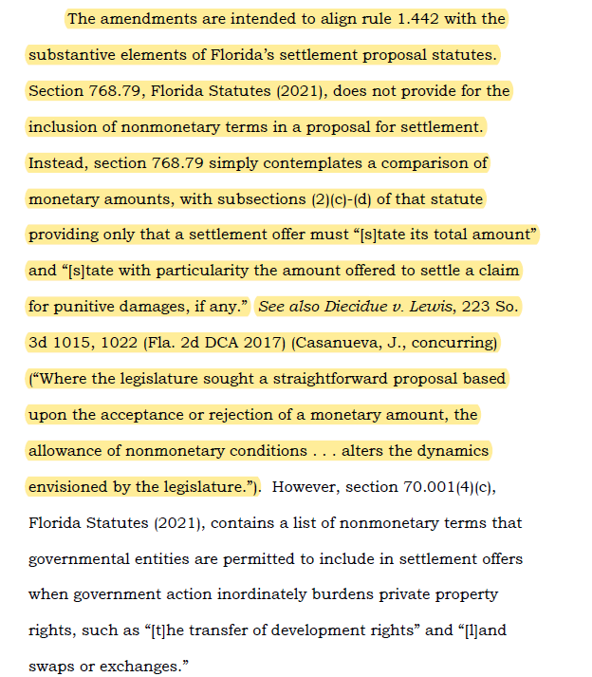
The Supreme Court Rule Change eliminates most non-monetary terms.

Slide 14
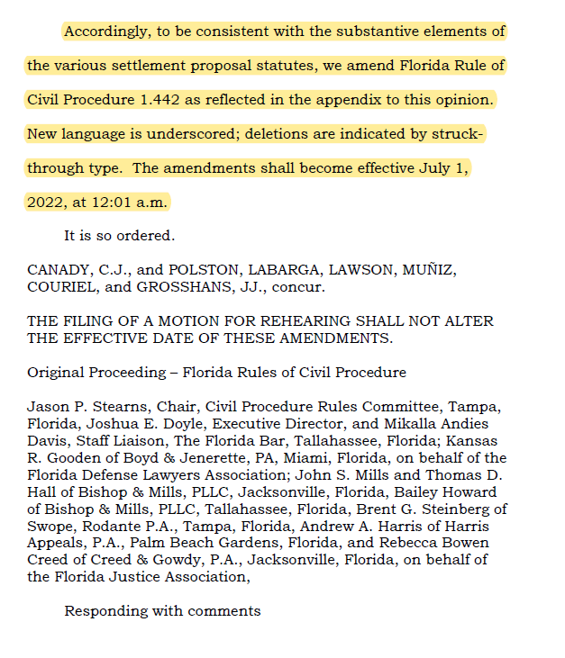
The Supreme Court Rule Change eliminates most non-monetary terms.

Slide 15
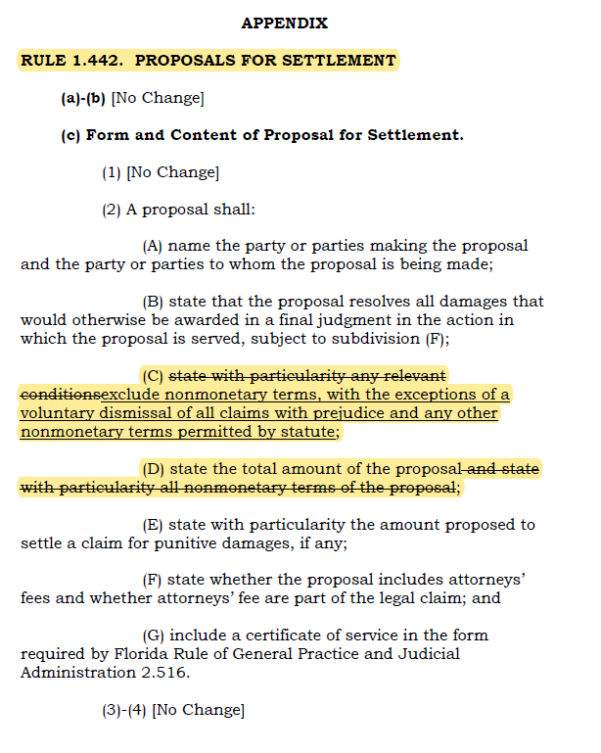
The amended Rule 1.442, Proposals for Settlement. Effective July 1, 2022.
.

Slide 16
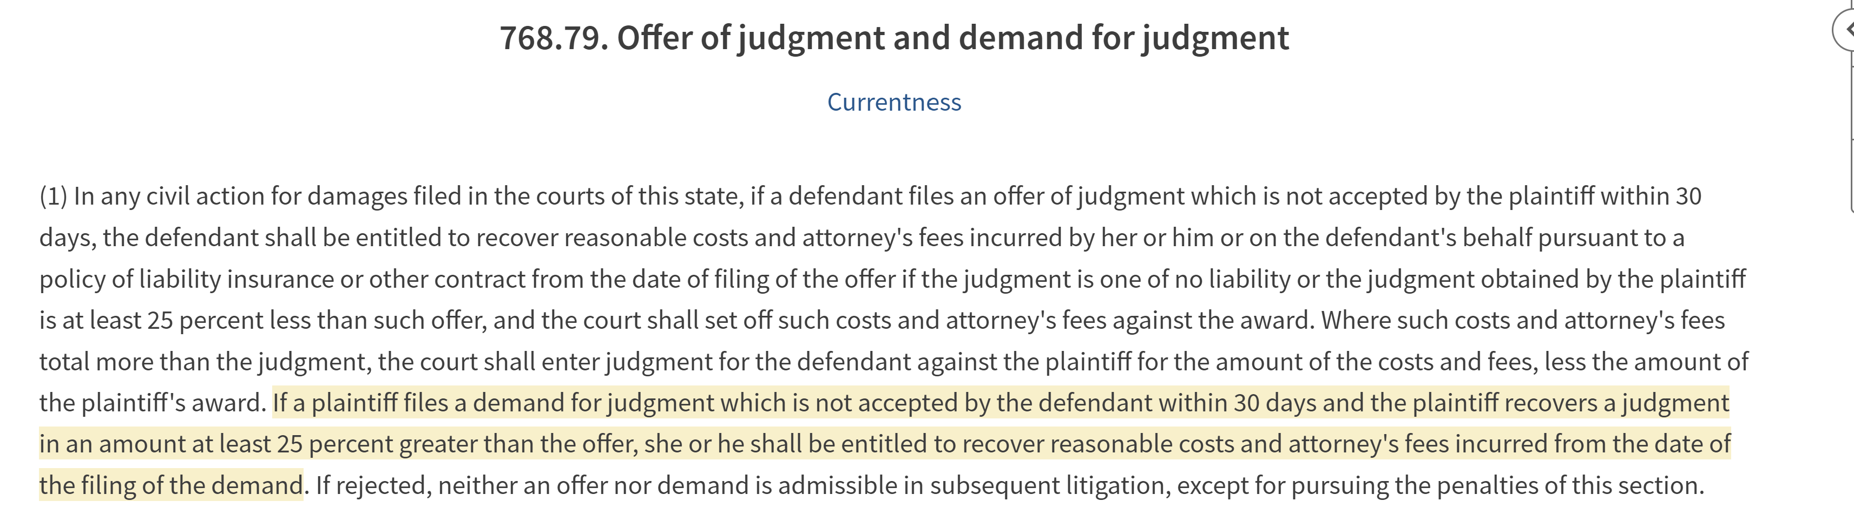
Section 768.79: Offer of Judgment and
Demand For Judgment.
.

Slide 17
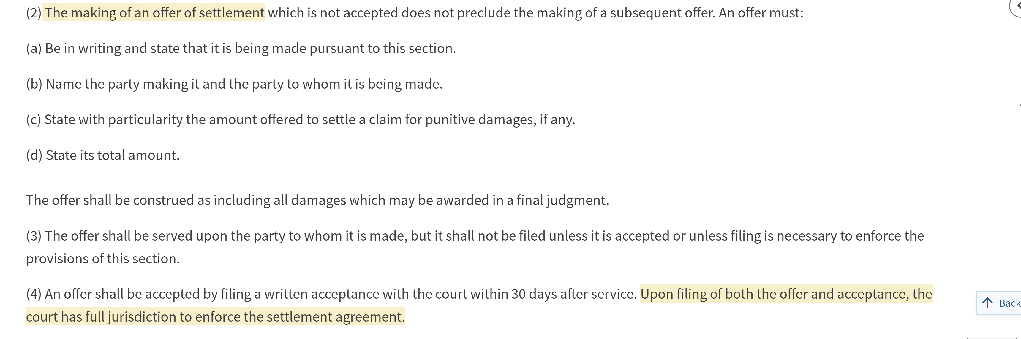
Section 768.79: Offer of Judgment and
Demand For Judgment.

Slide 18
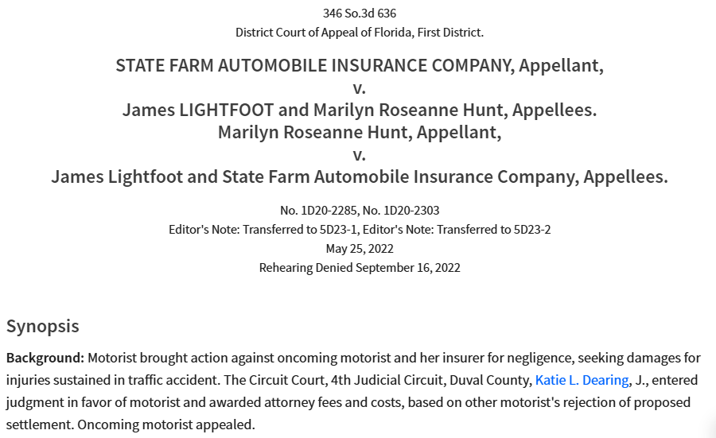

Slide 19
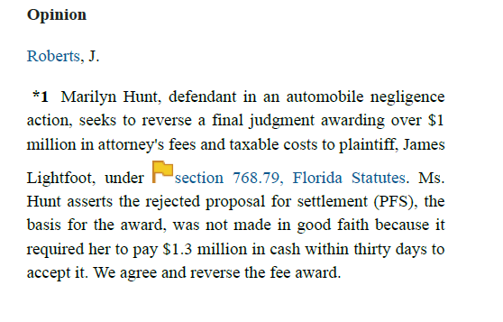
State Farm v. Lightfoot, 346 So. 3d 636 (Fla. 1st DCA 2022), review denied.

Slide 20
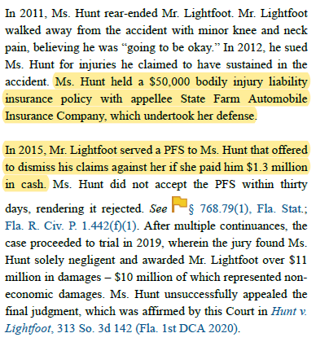
State Farm v. Lightfoot, 346 So. 3d 636

Slide 21
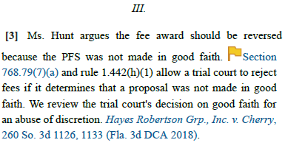
State Farm v. Lightfoot, 346 So. 3d 636

Slide 22
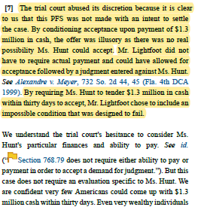
State Farm v. Lightfoot, 346 So. 3d 636

Slide 23
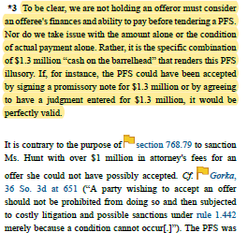
State Farm v. Lightfoot, 346 So. 3d 636

Slide 24
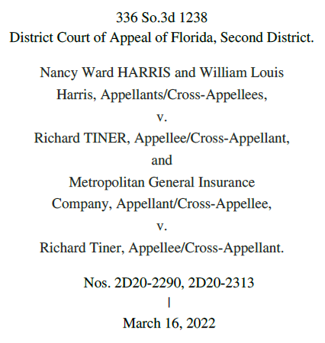

Slide 25
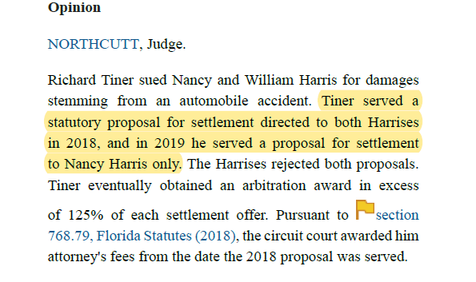
Harris v. Tiner, 336 So. 3d 1238.

Slide 26
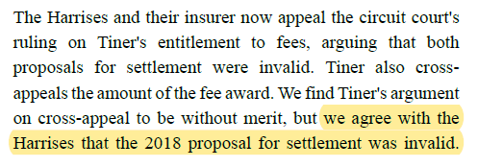
Harris v. Tiner, 336 So. 3d 1238.

Slide 27
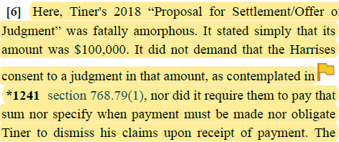
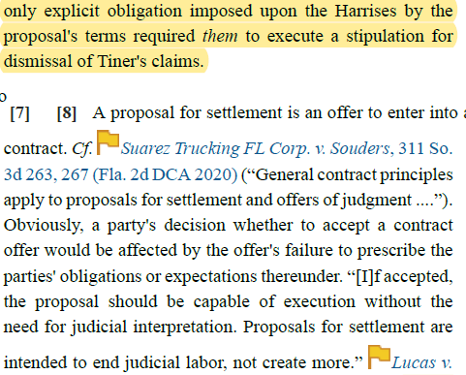
Harris v. Tiner, 336 So. 3d 1238.

Slide 28
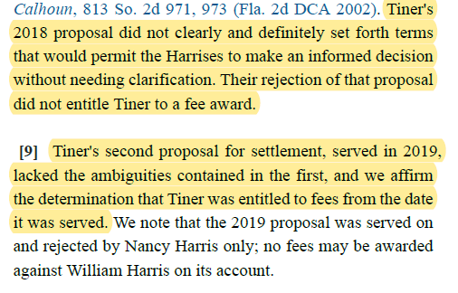
Harris v. Tiner 336 So. 3d 1238.

Slide 29
Proposals for Settlement and Payment Issues
  The plaintiff’s proposals for settlement stated that “[t]his proposal is conditioned upon payment of this settlement proposal within the relevant 30–day service period.” Ghazzawieh v. Iglesias, 336 So. 3d 1254 (Fla. 5th DCA 2022).
  Is this a valid term?
  The defendant’s [lone] argument was that the proposals improperly shortened the 30-day time period to accept as provided for in the statute and rule.
  The appellate court rejected this. “As the [plaintiff] correctly observes, a tender of payment and a written acceptance of the proposal for settlement could have been made simultaneously.” Id. at 1255.
  The 5th DCA concluded with a comment:
  Our affirmance of the trial court's order should not be construed as a determination that the proposals for settlement at issue strictly complied with section 768.79 and rule 1.442. Rather, our opinion reflects a rejection of the sole argument made on appeal by Appellants on the issue.

Slide 30
Proposals for Settlement and Payment Issues
  SDG Dadeland Assocs., Inc. v. Arias, 388 So. 3d 916 (Fla. 3d DCA 2024).
  Plaintiff sued two Defendants in a mall slip and fall. The mall and its janitor contractor. The contractor agreed to indemnify the mall for the incident.
  The Defendants served a PFS for $5,000. The Plaintiff did not accept, and the Defendants prevailed at trial.
  The trial court held the PFS was invalid.

Slide 31
Proposals for Settlement and Payment Issues
  SDG Dadeland Assocs., Inc. v. Arias, 388 So. 3d 916 (Fla. 3d DCA 2024).
3. The Applicable Claims
The claims this Proposal for Settlement attempts to resolve are all claims asserted by the Plaintiff, KENYA ARIAS, against Defendants, SDG DADELAND ASSOCIATES, INC. & NATIONWIDE JANITORIAL SERVICES, INC., in the operative complaint in Eleventh Judicial Circuit case no. 2018-006862-CA-01 (i.e., the above-styled cause and the action in which the instant proposal is being served). As specified in Fla. R. Civ. P. 1.442(c)(2)(B), this Proposal for Settlement resolves all damages that would otherwise be awarded in a final judgment in the action in which the proposal is served.
4. Relevant Conditions
This Proposal for Settlement is conditioned on Plaintiff, KENYA ARIAS, voluntarily dismissing, with prejudice, the entirety of Eleventh Judicial Circuit case no. 2018-006862-CA-01 as to all Defendants.
5. Total Amount of Proposal
The total amount of this Proposal for Settlement is Five Thousand Dollars ($5,000.00). Regarding the amounts attributable to each Defendant, and pursuant to Fla. R. Civ. P. 1.442(c)(3), this joint proposal shall be: (a) a contribution of Five Thousand Dollars ($5,000.00) from NATIONWIDE JANITORIAL SERVICES, INC.; and (b) a contribution of Zero Dollars ($0.00) from SDG DADELAND ASSOCIATES, INC. Except as otherwise described herein, this Proposal for Settlement has no remaining non-monetary terms.

Slide 32
Proposals for Settlement and Payment Issues
  The Third DCA held the PFS was enforceable.
  The PFS did not provide a payment date. But the Third DCA held this did not render the offer to be ambiguous. Both the statute and rule have settlement enforcement provisions.
  Note that the Third DCA explained that “practically” the offer did not require dismissal until payment was made.
  The offer did not say this expressly.

Slide 33
Proposals for Settlement and Payment Issues
  Entry of Judgment issue: The Third DCA also explained the PFS was not invalid bc it omitted any requirement for the entry of a judgment.
  The trial court had misconstrued the Harris v. Tiner decision.
  The $0 contribution from one Defendant, the mall owner.
  The Third DCA held this was not an improper term.
  The offer included a total amount, and allocated it between the two offerors.
  The defendants were both alleged to be directly liable, but the contractor indemnified the mall defendant. There was nothing improper with this particular offer where the contractor was contributing the entire settlement amount.

Slide 34
Demands for Judgment
Demands for Judgment don’t present these concerns.
Section 768.79 authorizes Demands for Judgment, also referring to them as Offers of Judgment. This presents the apples-to-apples comparison between the Demand and the end result of the case.
One clear issue: No money has to be paid by the defendant as a term of acceptance. Indeed, my advice is to steer away from that term in Demands.
The plaintiff will have a Judgment, and now has to enforce the Judgment.
This will not be a concern for Demands at or below policy limits, or for the Walmart and Publix collectible defendants of the world.

Slide 35
Demand for Judgment and Payment Issues
A Demand for Judgment does not require the payment of money.
  Indeed, from my perspective it should not even be asking for money.
Alexandre v. Moyer, 732 So. 2d 44 (Fla. 4th DCA 1999).
Personal-injury lawsuit, defendant with a $10,000 insurance policy. Before the lawsuit, plaintiff offered to settle for the limits. (Everyone should know of the HB 837 conditions precedent now).
During the lawsuit, the plaintiff served a Demand for Judgment for $76,000.
The Demand was not accepted, and the plaintiff prevailed with a net judgment of $183,000.
The Defendant’s argument: the Demand was not made in good-faith because of the policy limits and because the plaintiff knew “her demand could not result in a settlement.” Id. at 45.

Slide 36
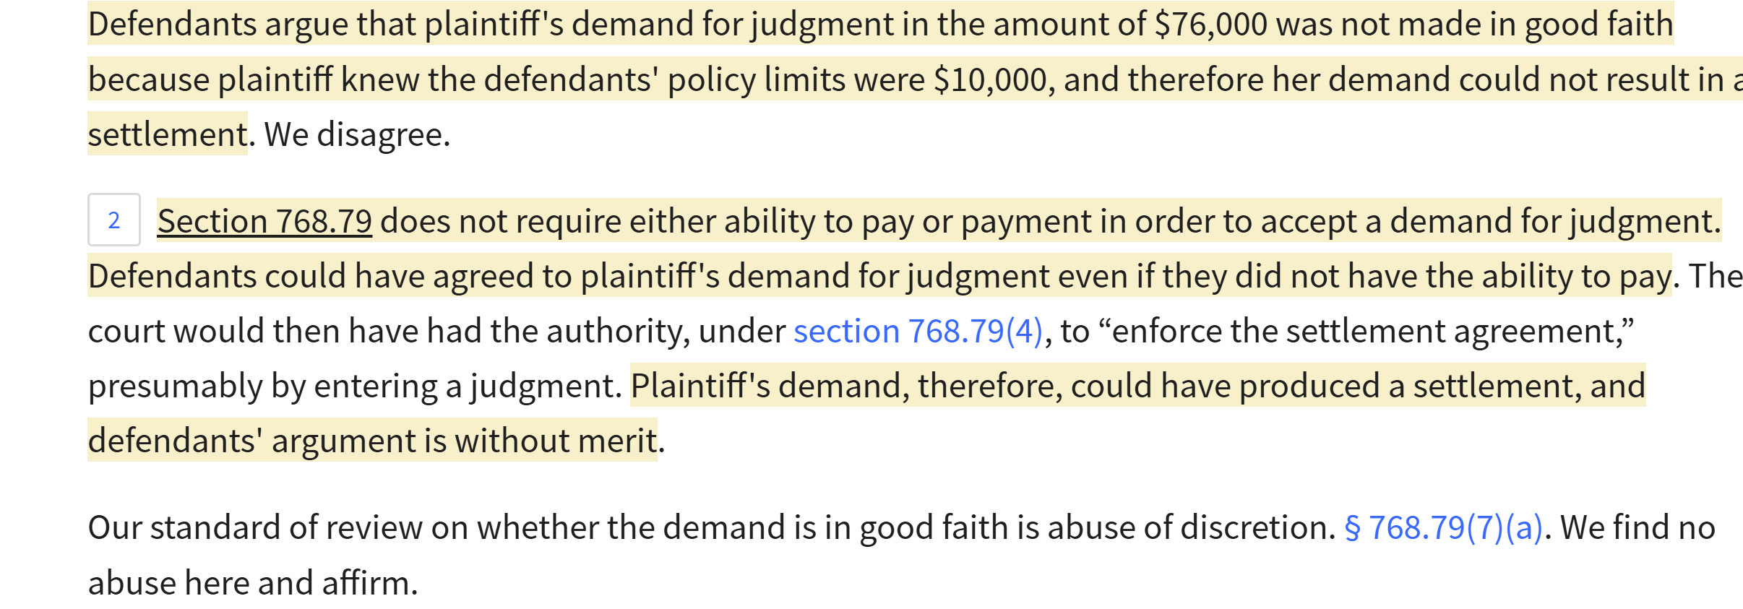
Demand for Judgment and Payment Issues
Alexandre v. Moyer, 732 So. 2d 44 (Fla. 4th DCA 1999).
The Fourth DCA’s discussion was rather succinct.

Slide 37
Non-Monetary Terms: What is still permitted?
The Supreme Court’s rule change recognizes that there must be an apples-to-apples comparison between an offer and the judgment.
The reason for this pretty simple in the end: Section 768.79 does not allow authorize non-monetary terms.
There are some terms & conditions that are clearly now prohibited.
Releases that include hold-harmless or indemnity provisions should not be permitted.
Releases that include confidentiality clauses should not be permitted.
Agreeing to satisfy liens sure seems like a non-monetary term.
Heck, I would argue even the most basic general release is not permitted, as it is not a monetary term, or authorized non-monetary term.

Slide 38
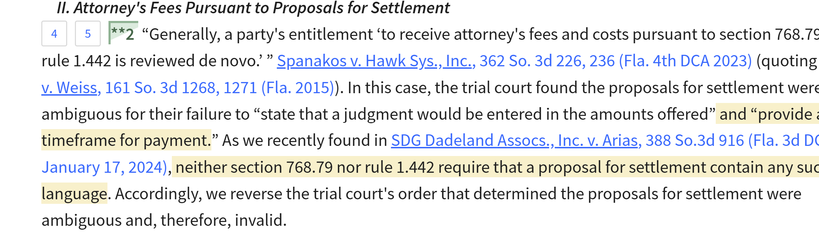
Non-Monetary Terms: What is still permitted?
Is a requirement to pay money by a certain date an authorized term?
As explained above, the Third DCA has held a PFS is not ambiguous for failing to include a payment date. SDG Dadeland Assocs., Inc. v. Arias, 388 So. 3d 916(Fla. 3d DCA 2024); and see Ortega v. All Dade Fences, Inc., 388 So. 3d 985(Fla. 3d DCA 2024):

Slide 39
Non-Monetary Terms: What is still permitted?
Is a requirement to pay money an authorized term?
The Third DCA was addressing offers without payment dates. Not offers with payment dates.
In the State Farm v. Lightfoot PFS case, State Farm argued in its appellate brief that payment can never be required in a Proposal for Settlement.
And this was before the rule change.

Slide 40
Non-Monetary Terms: What is still permitted?
Is a requirement to dismiss another party in the case an authorized term?
  There were only limited situations you could do this before the amendment to 1.442 in 2022 prohibiting nearly all non-monetary terms. [The vicarious liability exception in Rule 1.442].
  The 2022 rule change expressly allows voluntary dismissals of all claims with prejudice.
  Please don’t include this if you want to enforce a PFS.
Is an agreement to return money an authorized term?
  “Papera” Proposals. [Golisting.com v. Papera, 229 So. 3d 862 (Fla. 4th DCA 2017)].
  This refers to serving two Proposals at the same time, to different defendants. Included are terms that if one recipient accepts, both will be dismissed. And also terms that if somehow both recipients accepted, you would return half of each offer.
  Please don’t try this if you want to enforce a PFS.

Slide 41
Non-Monetary Terms: What is still permitted?
Can you condition an offer to a tortfeasor on the UM carrier waiving subrogation?
Section 627.727(6).
Recall Rule 1.442 allows non-monetary terms authorized by statute.
But nothing in the rule (or § 768.79) allows you to condition a settlement with a recipient on actions taken by another entity, even another party in the case.
A recipient must be able to independently evaluate the offer and accept it [a Gorka violation].
Attorneys’ Title Ins. Fund, Inc. v. Gorka, 36 So. 3d 646 (Fla. 2010).

Slide 42
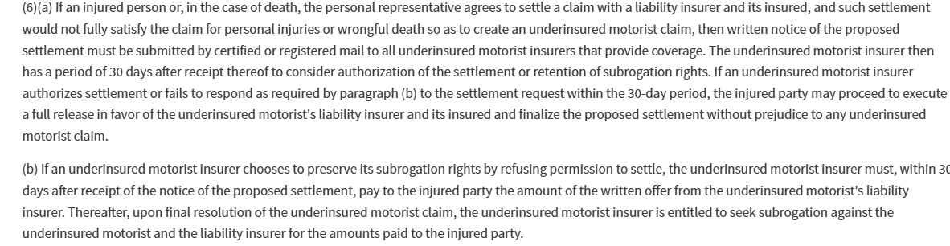
Non-Monetary Terms: What is still permitted?
Third-Party and UM case.
Section 627.727(6):

Slide 43
What statutory non-monetary terms exist?
627.4265. Payment of settlement
In any case in which a person and an insurer have agreed in writing to the settlement of a claim, the insurer shall tender payment according to the terms of the agreement no later than 20 days after such settlement is reached. The tender of payment may be conditioned upon execution by such person of a release mutually agreeable to the insurer and the claimant, but if the payment is not tendered within 20 days, or such other date as the agreement may provide, it shall bear interest at a rate of 12 percent per year from the date of the agreement; however, if the tender of payment is conditioned upon the execution of a release, the interest shall not begin to accrue until the executed release is tendered to the insurer.
  Ponder whether this applies to Proposals for Settlement,
  And ponder whether this applies to Proposals for Settlement served to an insured.

Slide 44
Filing a Notice that you’ve served a PFS or Demand for Judgment: Please do not do this.
PLEASE STOP filing a “Notice of Serving Proposal for Settlement.”
They are an unnecessary relic left over from the day when proposals were served by U.S. Mail and you needed a way to prove when you served them.
Nowadays, with email service, you have verifiable proof of when you served the proposal.
They are just one more opportunity to make a mistake. And many (we’re talking many) times, the notice and the proposal do not match. The most common mistake is to goof up the parties (especially where there is more than one party). And that creates fertile ground for your opponent to argue that there is an ambiguity.
If the notice is unnecessary, then why give yourself an opportunity for mistakes?

Slide 45
Don’t ever guarantee your client a defense offer is invalid
When an offer is served to your clients, what should you do?
Make sure you immediately send the offer in writing to your client.
Make sure you advise your client of the consequences of rejection.
Make sure you advise your client about PFS insurance.
Make sure you inform your client to promptly contact you.
Make sure you calendar a follow up for well before the 30 days.
Make sure your client’s decision is sent to you in writing, with a signature.
Do not tell your client the offer has no chance of being enforced.
Even if you think that is the case, you may be wrong. A trial judge may have a practical approach.

Slide 46
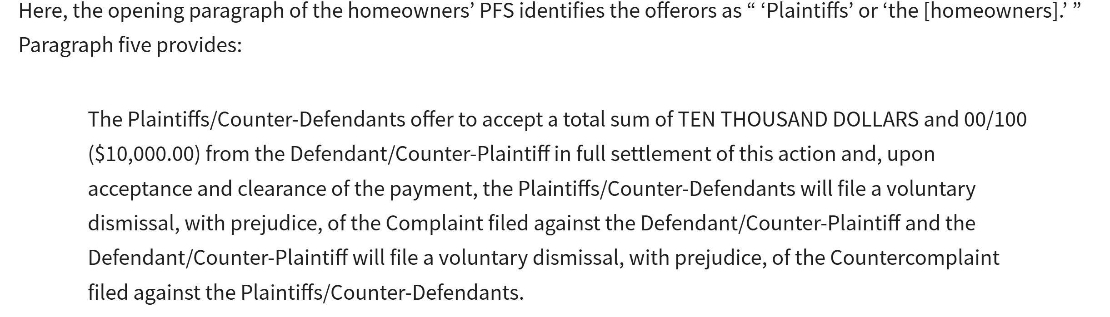
Don’t ever guarantee your client an opponent’s offer is invalid
Mackenson v. Trace Elements, Inc., 388 So. 3d 815 (Fla. 4th DCA 2024).
Professional design company performs works for a husband/wife homeowners.
The homeowners sue the design company for breach of contract and unjust enrichment.
The company countersues for breach of contract and tortious interference.
The Plaintiff homeowners serve a PFS to the design company defendant.

Slide 47
Don’t ever guarantee your client an opponent’s offer is invalid
Mackenson v. Trace Elements, Inc., 388 So. 3d 815 (Fla. 4th DCA 2024).
The two Plaintiffs, husband and wife, served an offer for $10,000 to the single Defendant. Mutual acceptance from both Plaintiffs was required. It would resolve all claims in the case, including counter-claims. The offer made clear the Defendant was paying the Plaintiffs this money.
Was this a valid offer?
I would have told you that procedurally, there was a 0.00% chance this was a technically valid offer.
There were two offerors. Any offer by two plaintiffs must allocate amounts for each of them. No matter the relationship between the plaintiffs.
I won a case in the Florida Supreme Court over a decade ago regarding the same issue.
The case I won led to the Rule 1.442 exception – which allows joint offers from defendants for a single amount of money only when there is faultless liability.

Slide 48
Don’t ever guarantee your client an opponent’s offer is invalid
Mackenson v. Trace Elements, Inc., 388 So. 3d 815 (Fla. 4th DCA 2024).
Well, this PFS that I told you had a 0.00% chance of being upheld -- at least under the case law -- was ruled to be enforceable.
The appellate briefing here was not ideal.
Our judges and their law clerks are human beings.
In a sensible world, many folks would say this PFS should be enforceable.
The two Plaintiffs had indistinguishable breach of contract claims for a home improvement contract.
Why should these Plaintiffs have had to allocate settlement amounts for each of them? (Note, this was not just a breach of contract case though).

Slide 49
Don’t ever guarantee your client an opponent’s offer is invalid
“The eligibility to receive attorney's fees and costs pursuant to section 768.79 and rule 1.442 is reviewed de novo.” Pratt v. Weiss, 161 So. 3d 1268, 1271 (Fla. 2015).
Florida Rule of Civil Procedure 1.442(c)(3) states: “[a] proposal may be made by or to any party or parties and by or to any combination of parties properly identified in the proposal. A joint proposal shall state the amount and terms attributable to each party.” Our supreme court “has held that subdivision (c)(3) of rule 1.442, which requires a joint proposal to state the amount and terms attributable to each offeror or offeree, must be strictly construed.” Pratt, 161 So. 3d at 1271.
“The purpose of the apportionment requirement in the rule is to allow each offeree to evaluate the terms and the amount of the offer as it pertains to him or her.” Id. at 1272. “Strict application of the requirement has resulted in the invalidation of offers of judgment where two plaintiffs presented an unapportioned settlement offer to one defendant ....” Id.
Nevertheless, if two parties file “a unified, single insurance claim for damages,” apportionment is unnecessary. See Hall v. Lexington Ins. Co., 895 So. 2d 1161, 1166 (Fla. 4th DCA 2005). In Hall, an insurer made an offer of settlement to two homeowners without apportioning the amount to each. We held that apportionment was not required because of the unified, single nature of the homeowners’ claim.

Slide 50
Don’t ever guarantee your client an opponent’s offer is invalid
“Like Hall, the homeowners made a unified, single claim for damages. Like Hall, the homeowners were represented by the same lawyer. Like Hall, there was no conflict of interest between the two homeowners.
In short, the homeowners’ PFS was a joint proposal regarding a unified, single claim, which did not require apportionment to comply with rule 1.442. We therefore reverse and remand for the trial court to award attorney's fees to the homeowners.”
  Here’s the reality: There is no “unified single nature” of claim exception that exists in Florida here in 2025.
  The Fourth DCA cited to an earlier 2005 case from the Court recognizing that exception. But at the same time, the Fourth DCA cited to the Supreme Court’s 2012 case that explained there were no such exceptions.

Slide 51
Don’t ever guarantee your client an opponent’s offer is invalid
Here’s what the Fourth DCA missed. The year after its 2005 decision [Hall] recognizing an exception, the same Court issued another decision explaining Hall was no longer good law in light of a recent Florida Supreme Court case.
The Fourth DCA here in 2024 missed its own 2006 decision.
The Fourth DCA appellate briefing did not mention the 2006 decision. [Graham v. Peter K. Yeskel 1996 Revocable Trust, 928 So. 2d 371 (Fla. 4th DCA 2006).
I was contacted after the Fourth DCA’s decision. The Fourth DCA denied rehearing. But the Florida Supreme Court has accepted review. SC2024-1274, 2025 WL 654983.
My Initial Brief is due in a few weeks. I am going to be serving a Section 57.105 Motion to the plaintiff homeowners here. Their position is indefensible under Florida law. But … they won in the Fourth DCA.
The moral of the story here: Please don’t tell your client there is no chance a rejected offer will be enforced.

Slide 52
Client Authority and Care in Serving Offers
Neeld v. Combs, 2025 WL 498011 (Fla. 5th DCA Feb. 14, 2025).
Car Accident case. Defendant with a $1 million dollar policy.
Plaintiff demands $275,000 pre-suit.
In suit, Plaintiff’s counsel serves a PFS for $100,000.
29 days later, the attorneys have a phone call discussing the offer.
Within 5 minutes of the phone call ending, defense counsel files a Notice of Acceptance.
The problem: Plaintiff had a math problem in the offer.
It is clear Plaintiff meant to serve an offer for policy limits, the $1m.

Slide 53
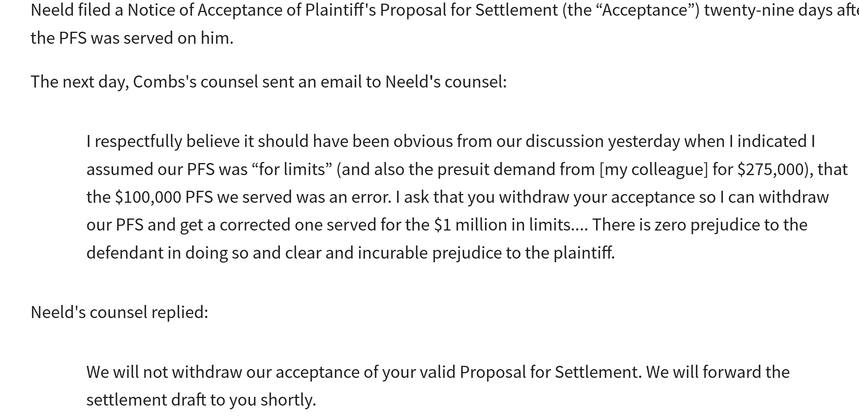
Client Authority and Care in Serving Offers
Neeld v. Combs, 2025 WL 498011 (Fla. 5th DCA Feb. 14, 2025).

Slide 54
Client Authority and Care in Serving Offers
Neeld v. Combs, 2025 WL 498011 (Fla. 5th DCA Feb. 14, 2025).
Four-plus months later, Plaintiff moves to withdraw the PFS and have it set aside.
Plaintiff claims the drafting error should have been obvious to the defense.
Plaintiff also says there was no client authority for the PFS.
There is no evidentiary hearing.
There is nothing in the Record indicating any evidence was offered by the Plaintiff.
The trial court holds the PFS cannot be enforced.
The Defendant immediately appeals (an appellate rule allows for this type of appeal).
What does the Fifth DCA do here?
A 2-1 decision, upholds the enforcement of this offer.

Slide 55
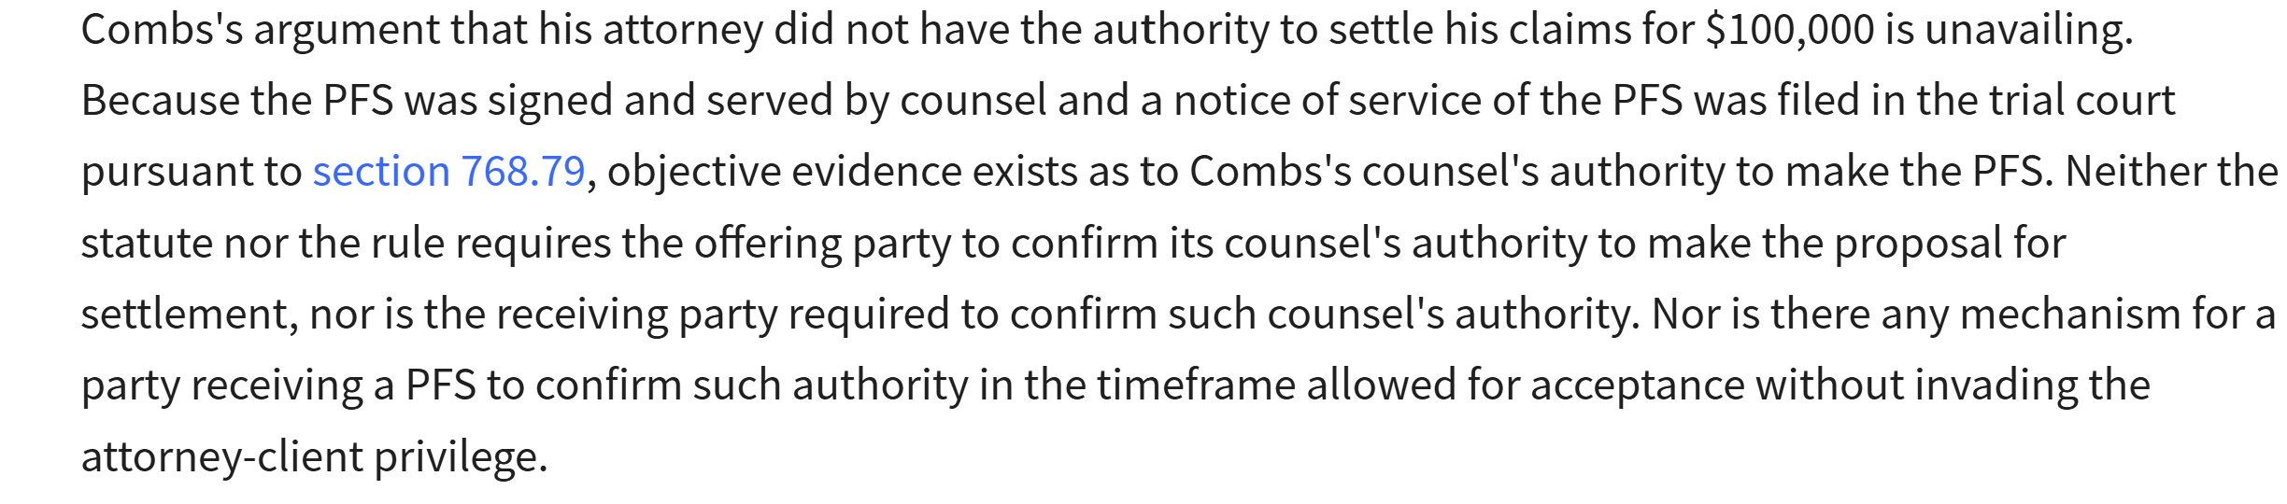
Client Authority and Care in Serving Offers
Neeld v. Combs, 2025 WL 498011 (Fla. 5th DCA Feb. 14, 2025).
The Majority holds there is a binding settlement agreement.
There is a “simple and straightforward” statutory framework for accepting offers. (citing Suarez Trucking v. Souders, 350 So. 3d 38 (Fla. 2022)).
The lack of client authority argument failed here.

Slide 56
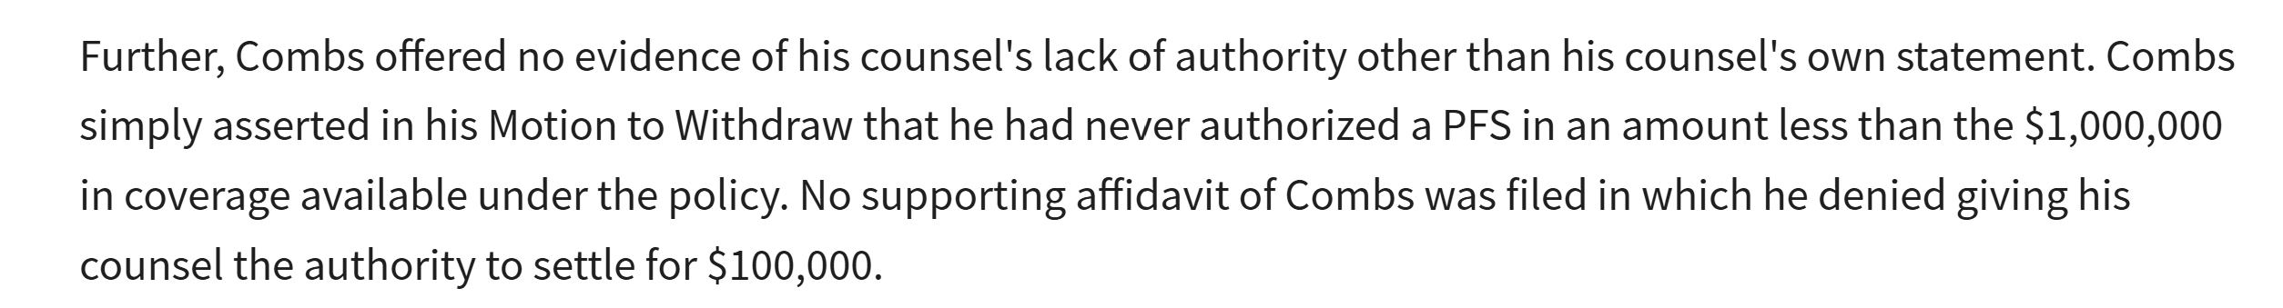
Client Authority and Care in Serving Offers
Neeld v. Combs, 2025 WL 498011 (Fla. 5th DCA Feb. 14, 2025).
There is a long line of case law explaining that express client authority is needed to settle cases.
Indeed, the Bar Rules make that point clear.
But the Majority here apparently deemed that case law inapplicable in the PFS world.
The Majority noted the Plaintiff did not present ANY evidence of a lack of client authority.

Slide 57
Client Authority and Care in Serving Offers
Neeld v. Combs, 2025 WL 498011 (Fla. 5th DCA Feb. 14, 2025).
The Majority also rejects any attempt to get out of the settlement due to a “unilateral mistake.”
The Majority concludes that “common law methods for attacking the formation of a contract are unavailable to unwind” PFS agreements.
The Majority concludes that Suarez Trucking takes PFS offers outside of traditional contract law.
The dissent discusses the specifics of plaintiff and defense counsel’s phone conversation in the minutes before defense counsel accepted the offer.
It seems clear defense counsel knew the $100,000 offer was a mistake from the phone call.
The end result here is an apparent $900,000 legal malpractice possible claim (or more) against Plaintiff’s counsel in serving this offer.

Slide 58
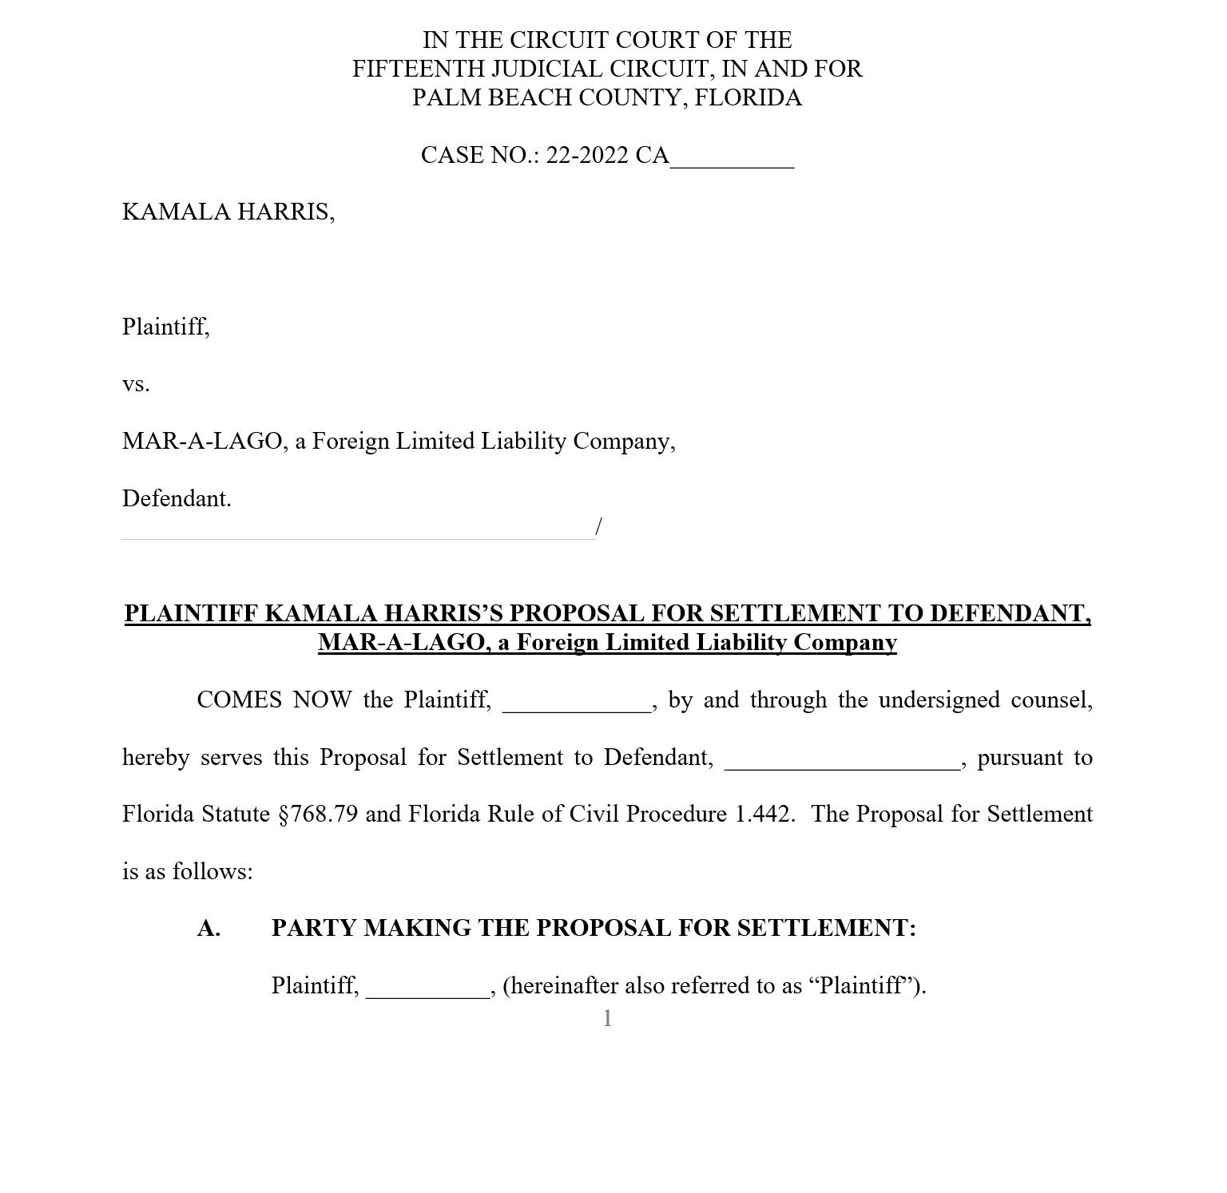
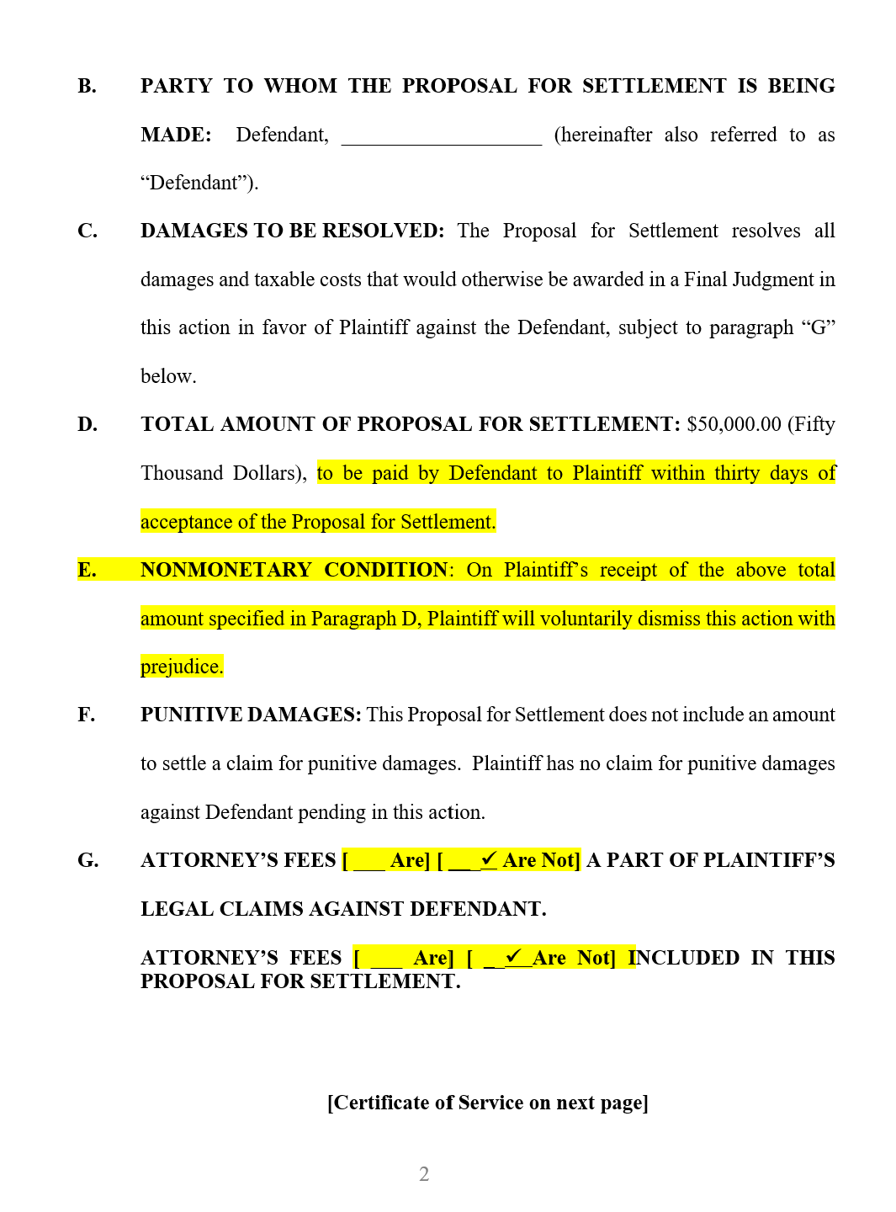
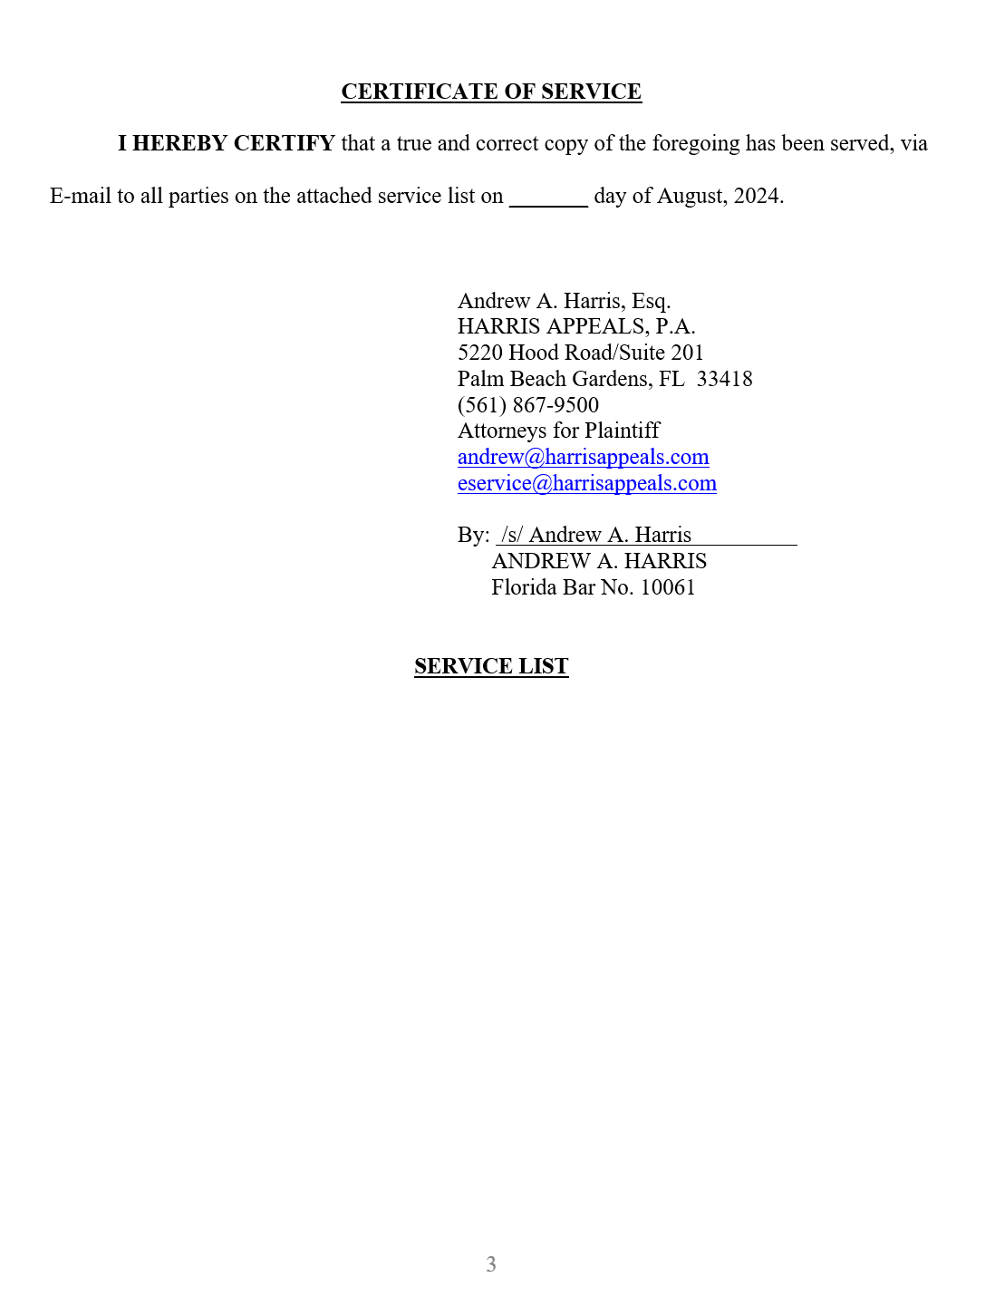
Sample Proposal for Settlement
[one plaintiff one defendant case]

Slide 59
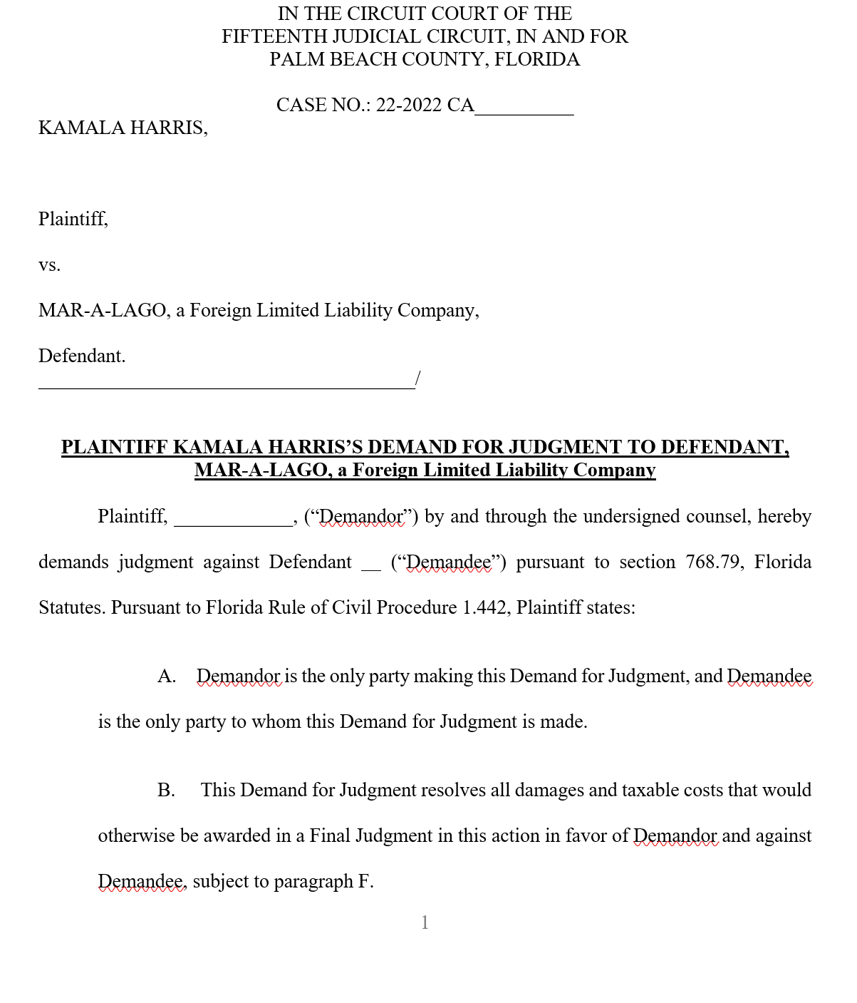
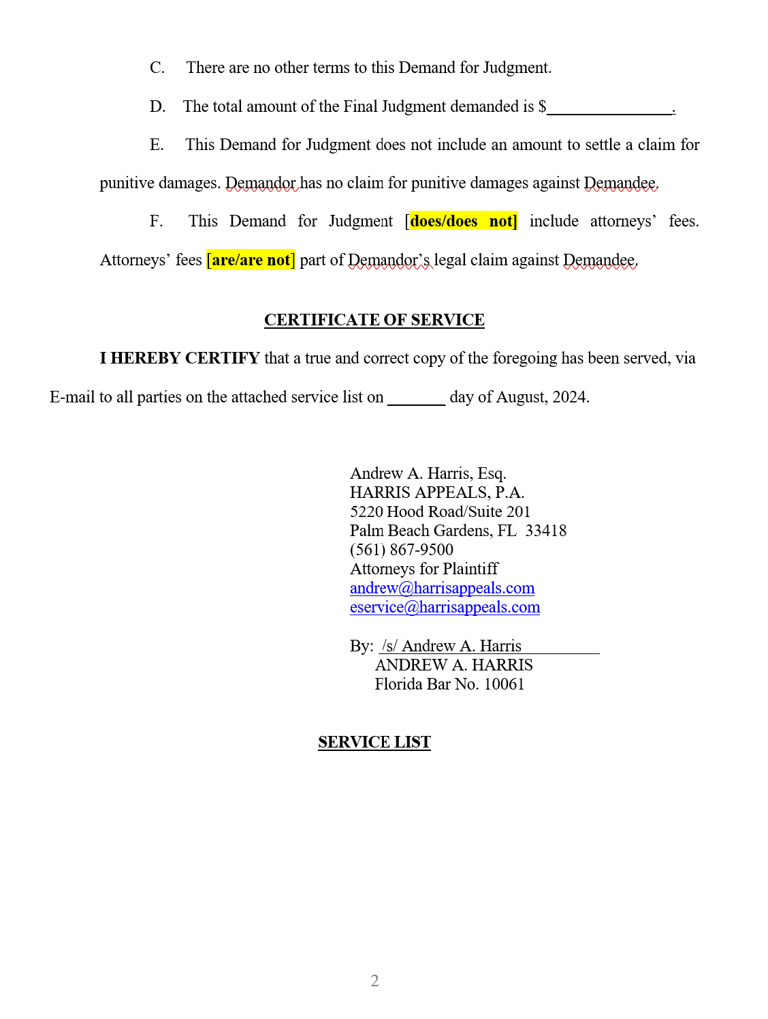
Sample Demand for Judgment
[one plaintiff one defendant case]

Slide 60
Single Plaintiff/Single Defendant Proposal for Settlement-Sample
PARTY MAKING THE PROPOSAL FOR SETTLEMENT: Plaintiff, Kamala (“Plaintiff”).
PARTY TO WHOM THE PROPOSAL FOR SETTLEMENT IS BEING MADE: Defendant, Donnie (“Defendant”).
DAMAGES TO BE RESOLVED: The Proposal for Settlement resolves all damages and taxable costs that would otherwise be awarded in a Final Judgment in this action between Plaintiff and Defendant, subject to subdivision “G” below.
TOTAL AMOUNT OF PROPOSAL FOR SETTLEMENT: $100,000.00, to be paid by Defendant to Plaintiff, within thirty days of acceptance of the Proposal for Settlement.
NONMONETARY CONDITION: Upon Plaintiff’s receipt of the above total amount specified in Paragraph D, Plaintiff will voluntarily dismiss this action with prejudice.
PUNITIVE DAMAGES: There is no claim for punitive damages in this action, and thus no portion of the total amount of the Proposal for Settlement is for punitive damages.
ATTORNEY’S FEES [ ___ Are] [ _✓_ Are Not] A PART OF THE PLAINTIFF’S LEGAL CLAIMS AGAINST THE DEFENDANT.
ATTORNEY’S FEES [ ___ Are] [ _✓_ Are Not] INCLUDED IN THIS PROPOSAL FOR SETTLEMENT.
Notes:
If you’re more comfortable naming out the Plaintiff and Defendant every place within the PFS, that is just fine.

Slide 61
Single Plaintiff/Single Defendant: Consider a Demand for Judgment instead
In this scenario, the Plaintiff’s proposed amount is $100,000.
If you have an insurance policy for this amount or greater, why not instead serve a Demand for Judgment? I strongly recommend that instead.
Under the limited facts, you don’t know if this defendant is collectible.
If there is no insurance coverage, or if there is coverage for less than $100,000, this does bring up the one problem with a Demand for Judgment. If the recipient accepts the Demand, the case concludes and you have no assurance of payment.
There are more risks with enforcing a rejected PFS than a rejected Demand for Judgment.
Notes:
If you’re more comfortable naming out the Plaintiff and Defendant every place within the PFS, that is just fine.

Slide 62
Single Plaintiff/One Defendant in multi-defendant case
PARTY MAKING THE PROPOSAL FOR SETTLEMENT: Plaintiff, Kamala (“Plaintiff”).
PARTY TO WHOM THE PROPOSAL FOR SETTLEMENT IS BEING MADE: Defendant, Mike (“this Defendant”).
DAMAGES TO BE RESOLVED: The Proposal for Settlement resolves all damages and taxable costs that would otherwise be awarded in a Final Judgment in this action between Plaintiff and this Defendant, subject to subdivision “G” below.
TOTAL AMOUNT OF PROPOSAL FOR SETTLEMENT: $100,000.00, to be paid by this Defendant to Plaintiff, within thirty day of acceptance of the Proposal for Settlement.
NONMONETARY CONDITION: Upon Plaintiff’s receipt of the above total amount specified in Paragraph D, Plaintiff will voluntarily drop this Defendant from this action with prejudice.
PUNITIVE DAMAGES: There is no claim for punitive damages in this action, and thus no portion of the total amount of the Proposal for Settlement is for punitive damages.
ATTORNEY’S FEES [ ___ Are] [ _✓_ Are Not] A PART OF THE PLAINTIFF’S LEGAL CLAIMS AGAINST THIS DEFENDANT.
ATTORNEY’S FEES [ ___ Are] [ _✓_ Are Not] INCLUDED IN THIS PROPOSAL FOR SETTLEMENT.
Notes:
If you prefer, instead of using phrases like “this Defendant,” you can name the particular defendant out each time. Either way, what is important is you don’t create an arguable ambiguity as to the parties on the Plaintiff and Defendant side.

Slide 63
DRAFTING TIP
A single Plaintiff must make a separate Proposal or Demand to each Defendant in multiple Defendant cases to comply with the law requiring that each recipient (with the one noted exception of vicarious liability) should be able to evaluate the offer independently.
Attorneys’ Title Ins. Fund, Inc. v. Gorka, 36 So. 3d 646 (Fla. 2010).
  Supreme Court holds that recipients must be able to independently evaluate the offer and accept or reject as they please. Acceptance cannot be conditioned on another recipient also having to accept, no matter what the relationship between the recipients, spouses, corporation and its sole employee, etc.
It was after this decision that Rule 1.442(c)(3)-(4) was amended to address pure vicarious liability situations, where there no longer must be an allocation in pure vicarious liability cases.

Slide 64
Single Plaintiff/2 Defendants, in 2-defendant case where you solely allege vicarious against one Def.
PARTY MAKING THE PROPOSAL FOR SETTLEMENT: Plaintiff, Kamala (“Plaintiff”).
PARTIES TO WHOM THE PROPOSAL FOR SETTLEMENT IS BEING MADE: Defendants, Mike, and Donald (“Defendants”).
DAMAGES TO BE RESOLVED: The Proposal for Settlement resolves all damages and taxable costs that would otherwise be awarded in a Final Judgment in this action between Plaintiff and the Defendants subject to subdivision “G” below.
TOTAL AMOUNT OF PROPOSAL FOR SETTLEMENT: $100,000.00, to be paid by the Defendants to Plaintiff, within thirty days of acceptance of the Proposal for Settlement.
NONMONETARY CONDITION: Upon Plaintiff’s receipt of the above total amount specified in Paragraph D, Plaintiff will voluntarily dismiss this action with prejudice.
PUNITIVE DAMAGES: There is no claim for punitive damages in this action, and thus no portion of the total amount of the Proposal for Settlement is for punitive damages.
ATTORNEY’S FEES [ ___ Are] [ _✓_ Are Not] A PART OF THE PLAINTIFF’S LEGAL CLAIMS AGAINST THE DEFENDANTS.
ATTORNEY’S FEES [ ___ Are] [ _✓_ Are Not] INCLUDED IN THIS PROPOSAL FOR SETTLEMENT.
Notes:
If you prefer, instead of using phrases like “this Defendant,” you can name the particular defendant out each time. Either way, what is important is you don’t create an arguable ambiguity as to the Defendant or Defendanrs here.

Slide 65
DRAFTING TIP
Multiple plaintiffs resolving their claims in a single PFS or Demand
PARTIES MAKING THIS PROPOSAL FOR SETTLEMENT: Plaintiffs, Kamala and Doug (“the Plaintiffs”).
B. PARTY TO WHOM THE PROPOSAL FOR SETTLEMENT IS BEING MADE: Defendant, Mike (“Defendant”).
C. DAMAGES TO BE RESOLVED: The Proposal for Settlement resolves all damages and taxable costs that would be awarded in a Final Judgment in this action in favor of the Plaintiffs against the Defendant, subject to subdivision “G” below.
TOTAL AMOUNT OF PROPOSAL FOR SETTLEMENT: $100,000.00, paid by the Defendant to the Plaintiffs, within thirty days of acceptance of the Proposal for Settlement Of this total amount, the Defendant will pay Plaintiff, Kamala, a total of $75,000, and the Defendant will pay Plaintiff, Doug, a total of $25,000.
NONMONETARY CONDITION: Upon the Plaintiffs’ receipt of the above total amount specified in Paragraph D, in the allotted amounts for each Plaintiff as specified in Paragraph D, the Plaintiffs will voluntarily dismiss this action with prejudice.
PUNITIVE DAMAGES: There is no claim for punitive damages in this action, and thus no portion of the total amount of the Proposal for Settlement is for punitive damages.
ATTORNEY’S FEES [ ___ Are] [ _✓_ Are Not] A PART OF THE PLAINTIFFS’ LEGAL CLAIMS AGAINST THE DEFENDANT.
ATTORNEY’S FEES [ ___ Are] [ _✓_ Are Not] INCLUDED IN THIS PROPOSAL FOR SETTLEMENT.

Slide 66
DRAFTING TIP
Serving a PFS to address punitive damages plead in Complaint
Scenario:
Kamala sues Mike for defamation.
The trial court has granted leave to Kamala to recover punitive damages. Amended Complaint is filed.
Kamala serves a PFS for $100,000.
She must allocate an amount for punitive damages. Can this be $0.00?
She cannot serve a PFS that allows Mike to accept just compensatory or punitive damages. [Rule 1.442 doesn’t allow you to resolve parts of a case between the parties to the PFS].
If the “net judgment” is $125,000+, Kamala gets her fees. Regardless of if she beats both compensatory + punitive by 25%+, under Frosti.

Slide 67
Single Plaintiff/Single Defendant with Punitive Damages plead in case.
PARTY MAKING THE PROPOSAL FOR SETTLEMENT: Plaintiff, Kamala (“Plaintiff”).
PARTY TO WHOM THE PROPOSAL FOR SETTLEMENT IS BEING MADE: Defendant, Mike (“Defendant”).
DAMAGES TO BE RESOLVED: The Proposal for Settlement resolves all damages and taxable costs that would otherwise be awarded in a Final Judgment in this action between Plaintiff and Defendant, subject to subdivision “G” below.
TOTAL AMOUNT OF PROPOSAL FOR SETTLEMENT: $100,000.00, to be paid by Defendant to Plaintiff, within thirty days of acceptance of the Proposal for Settlement.
PORTION OF TOTAL AMOUNT OF PROPOSAL FOR SETTLEMENT TO SETTLE THE PLAINTIFF'S CLAIMS FOR PUNITIVE DAMAGES AGAINST THIS DEFENDANT: $10,000
NONMONETARY CONDITION: Upon Plaintiff’s receipt of the above total amount specified in Paragraph D and as allocated in Paragraphs D and E, Plaintiff will voluntarily dismiss this action with prejudice.
ATTORNEY’S FEES [ ___ Are] [ _✓_ Are Not] A PART OF THE PLAINTIFF’S LEGAL CLAIMS AGAINST THE DEFENDANT.
ATTORNEY’S FEES [ ___ Are] [ _✓_ Are Not] INCLUDED IN THIS PROPOSAL FOR SETTLEMENT.

